Slide 1
Techniques for rare events:
TA-MD & TA-MC
Giovanni Ciccotti
University College Dublin
and
Università “La Sapienza” di Roma
In collaboration with:
Simone Meloni (UCD)
Sara Bonella (“La Sapienza”)
Michele Montererrante (“La Sapienza”)
Eric Vanden-Eijnden (Courant Inst., NYU)

Slide 2
Outline
The problem of rare events
Accelerating the sampling:
  Temperature Accelerated Molecular Dynamics (TAMD)
  Single Sweep Method
    Illustration: free energy surface of diffusing hydrogen in sodium alanates
  Temperature Accelerated Monte Carlo (TAMC)
    Illustrations: nucleation
Conclusions

Slide 3

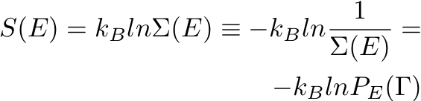
Probabilistic interpretation of the thermal properties
Entropy (Boltzmann)
and similarly in general ensembles
where is the probability density function of the given ensemble

Slide 4

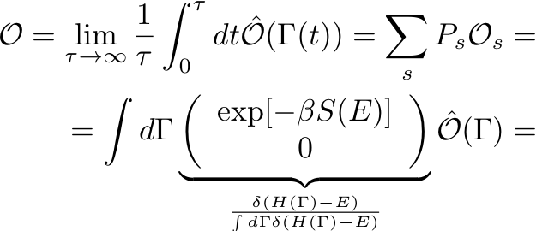

Mechanical vs thermal properties
Mechanical property
Thermal property

Slide 5

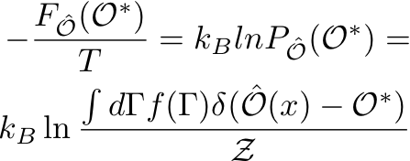
Free energy of collective variables
Given a collective variable (i.e. a function of the configuration space) , the free energy associated with its probability density function is

Slide 6




Rare events
If then

Slide 7

TAMD (Temperature Accelerated Molecular Dynamics)
Accelerating the sampling of the collective coordinates so as to sample , including the low probability regions (Vanden-Eijnden & Maragliano)
L. Maragliano and E. Vanden-Eijnden, Chem. Phys. Lett. 426 (2006), 168

Slide 8


TAMD
Extended (adiabatically separated) molecular dynamics
  atomic degrees of freedom ( )
  Extra degrees of freedom connected to the collective variables ( )
  Coupling potential term between and :

Slide 9
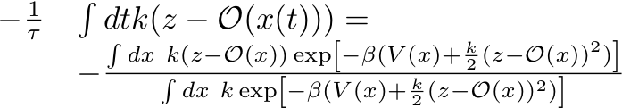
TAMD: adiabaticity
are much faster than
  moves according to the effective force
  (we have assumed that, apart for the , the remaining degrees of freedom of the system are ergodic)

Slide 10




TAMD: the strong coupling limit
Interpretation of the effective force as mean force

Slide 11




TAMD: collective variable at high temperature

Slide 12


TAMD and Single Sweep
The reconstruction of the free energy surface with TAMD still requires reliable sampling:
  Expensive if is function of many variables ( not much greater than 2)
Aim of the Single Sweep: to find an efficient alternative to the expensive thermodynamics integration, still taking advantage of the mean force computed a la TAMD

Slide 13

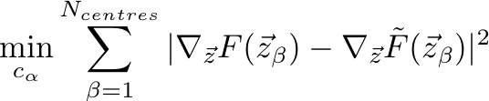
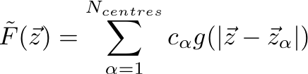
Single Sweep: free energy representation and reconstruction
Free energy represented over a (radial/gaussian) basis set
are determined by the least square fitting of :
L. Maragliano and E. Vanden-Eijnden, J. Chem. Phys. 128 (2008), 184110

Slide 14


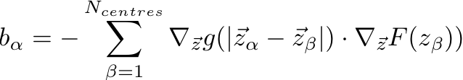
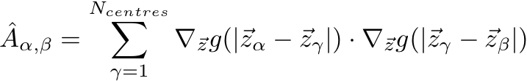

Single Sweep: reconstruction
What/where are the “centres”?
  What? Points on which we compute accurately the mean force and on which we centre our radial/gaussian basis set
  Where? They are identified during a TAMD run
    A new center is dropped along a TAMD trajectory when the distance of the from all the previous centres is greater than a given threshold
The least square procedure amounts to solve a linear system

Slide 15
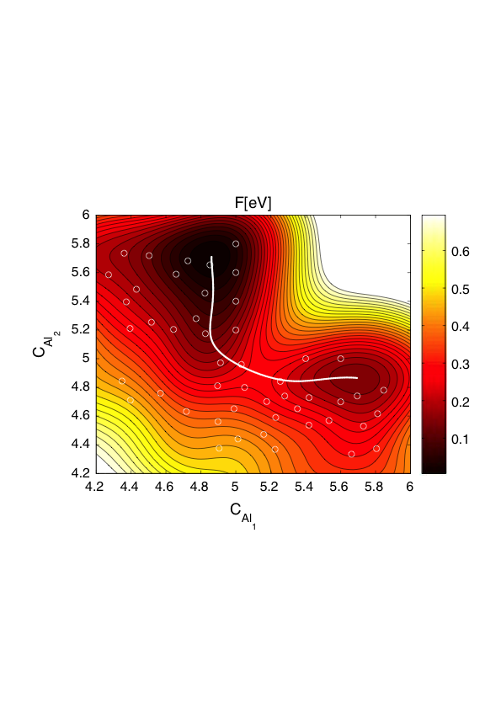
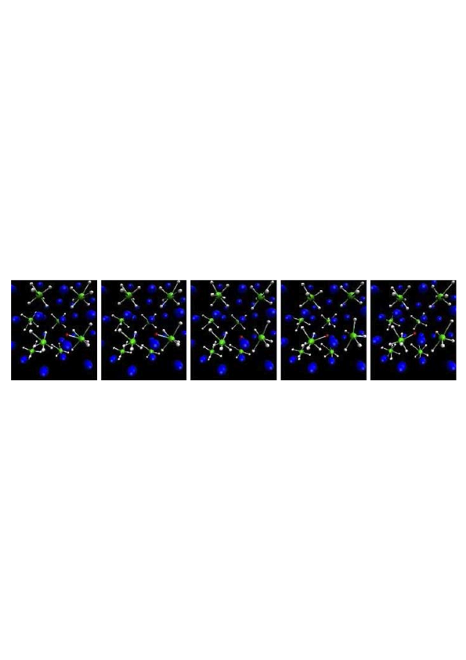
TAMD applied to the Hydrogen diffusion in defective Sodium Alanates (NaAlH₆)
Single Sweep
centre
dissociation
C_{Al1} and C_{Al2} coordination
number of Al₁ and Al₂
Mechanism: dissociation-recombination
recombination
M. Monteferrante, S. Bonella, S. Meloni, E. Vanden-Eijnden, G. Ciccotti, Sci. Model. Simul. 15 (2008), 187

Slide 16
TAMC: the problem of non-analytical Collective Variables
In TAMD nuclei evolve under the action of:
TAMD (but also Metadynamics, Adiabatic Dynamics, …) can be used only if the collective variable is an explicit-analytic function of the atomic positions

Slide 17


TAMC: Temperature Accelerated Monte Carlo
Idea: nuclei are evolved by MC instead than by MD according to the probability density function
are still evolved by MD under the force
  are configurations generated by MC

Slide 18


Adiabaticity in TAMC
evolved by MD, evolved by MC: adiabaticity is a loose concept that requires a strict definition
let be the characteristic time of the evolution
is the time step of MD
  is the number of timesteps for , i.e. for a significant displacement of
is the number of MC steps needed for (a good) sampling of
if , reaches the equilibrium and it is sampled at each value of : adiabaticity

Slide 19
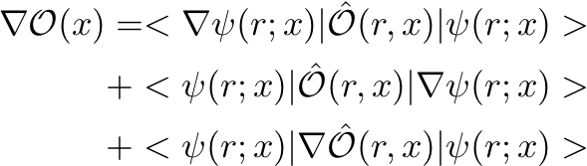

Where is TAMC extension important?
Classical cases
  Nucleation
  Rigorous collective variable to localize vacancies in solids
Quantum cases: let the observable be the quantum average then
therefore for TAMD, and similar techniques, we
need

Slide 20
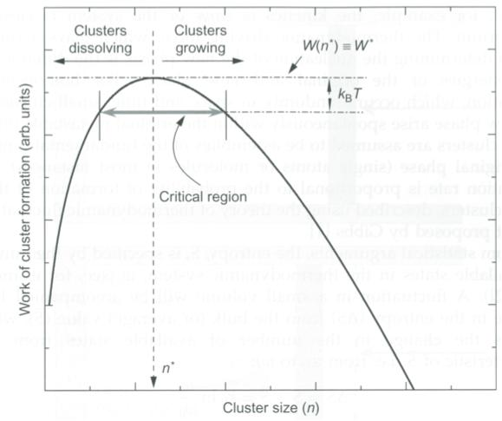
TAMC: application to the nucleation of a moderately undercooled L-J liquid
Targets
Get the free energy as a function of the number of atoms of a given crystalline nucleus
Critical size of the nucleus
Mechanism of growth of the nucleus (hopefully)
Typical free energy as function of the number of atoms in the crystalline nucleus

Slide 21

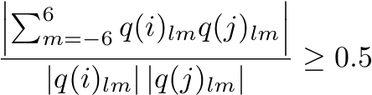

Collective variable for nucleation
Nucleus Size (NS):
  Number of atoms in the largest cluster of (i) connected, (ii) crystal-like atoms
  (i) Two atoms with are connected when their are almost parallel¹
  (ii) Crystal-like atoms: atoms with 7 or more connected atoms¹
To identify the largest cluster one has to use methods of graph theory (e.g. the “Deep First search” which we used)
  The NS is mathematically well defined but non analytical
1) P. R. ten Wolde, M. J. Ruiz-Monter and D. Frenkel, J. Chem. Phys. 104 (1996) 9932

Slide 22
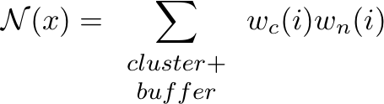
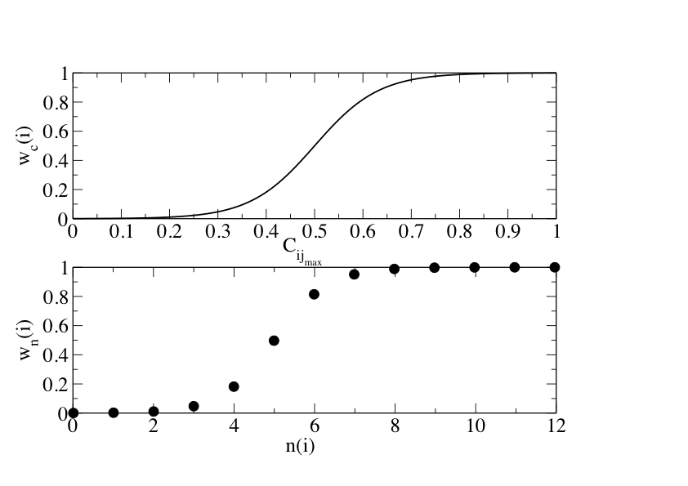

Effective Nucleus Size
is not efficient with TAMC: being discrete TAMC is accelerated only when a changes of one unit happens, a non frequent event
Smoothing :
Effective Nucleus Size (ENS)
the buffer atoms are those
with from the
cluster atoms

Slide 23
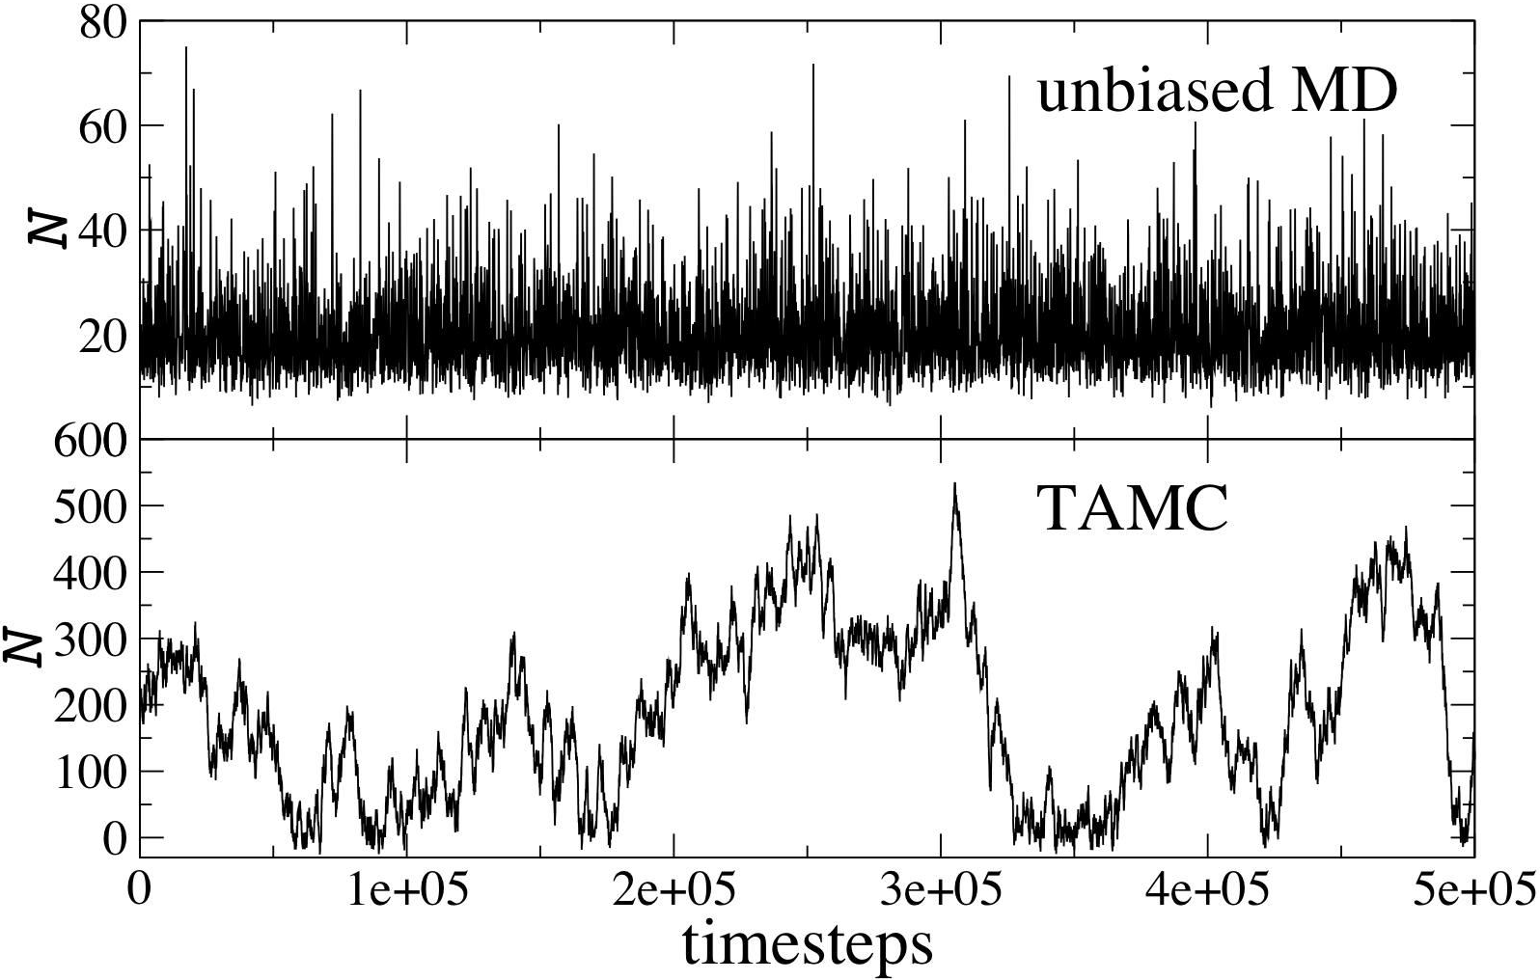
Results: timeline MD vs TAMC

Slide 24
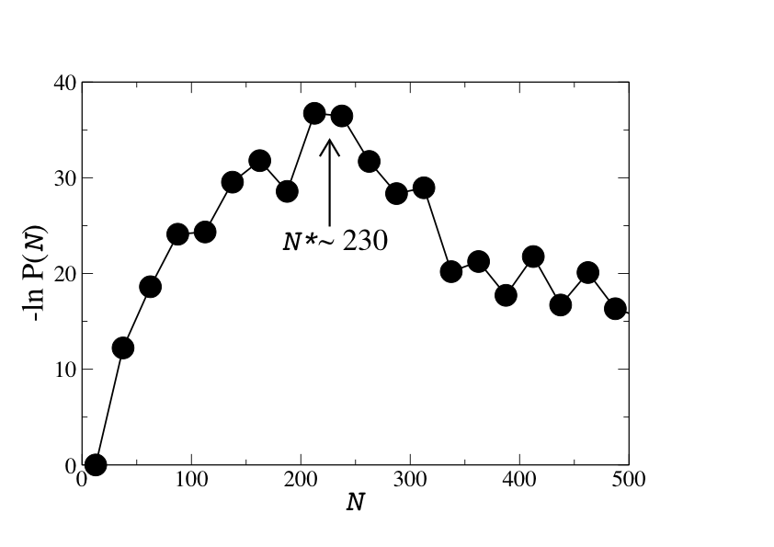
Results: free energy vs

Slide 25
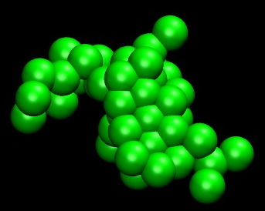
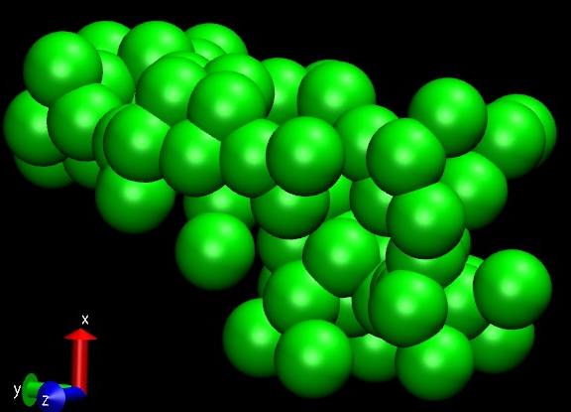
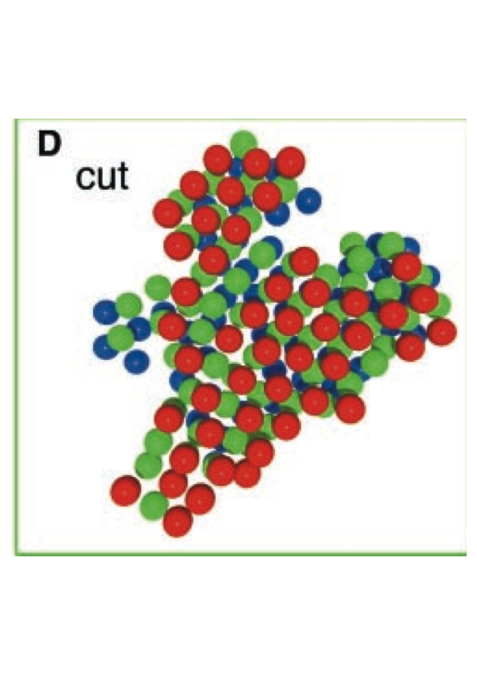
Results: nucleus configurations
3-layers thick cut through a post-critical nucleus in our simulations
3-layers thick cut through a post-critical nucleus of colloids (by 3D imaging¹)
an under-critical nucleus in our simulations
1) U. Gasser, E. R. Weeks, A. Schofield, P. N. Pusey, D. A. Weitz, Science 292 (2001), 258

Slide 26
Conclusions
Single Sweep with TAMD gives a powerful method to explore and compute the free energy associated with interesting phenomenologies
The limitation associated with the definition of the collective variables, which forbids a range of important applications, has been removed by TAMC
The large field of ab-initio models, in which the observables are quantum averages, is now open to study

