Slide 1

Modeling the phase transformation which controls the mechanical behavior of a protein filament
Peter Fratzl
Matthew Harrington
Dieter Fischer
Potsdam, Germany
108th STATISTICAL MECHANICS CONFERENCE
December 2012

Slide 2

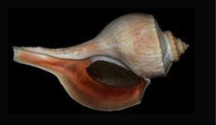
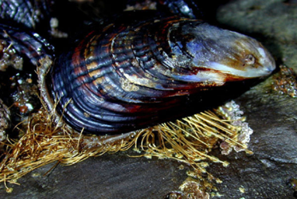
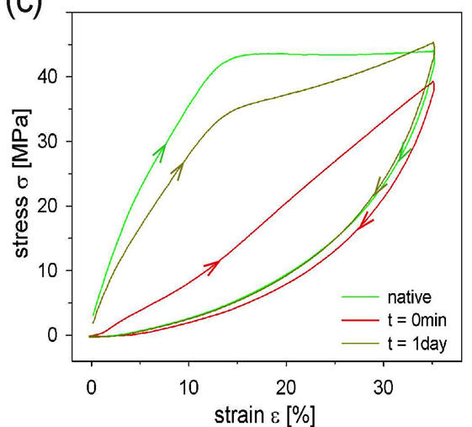
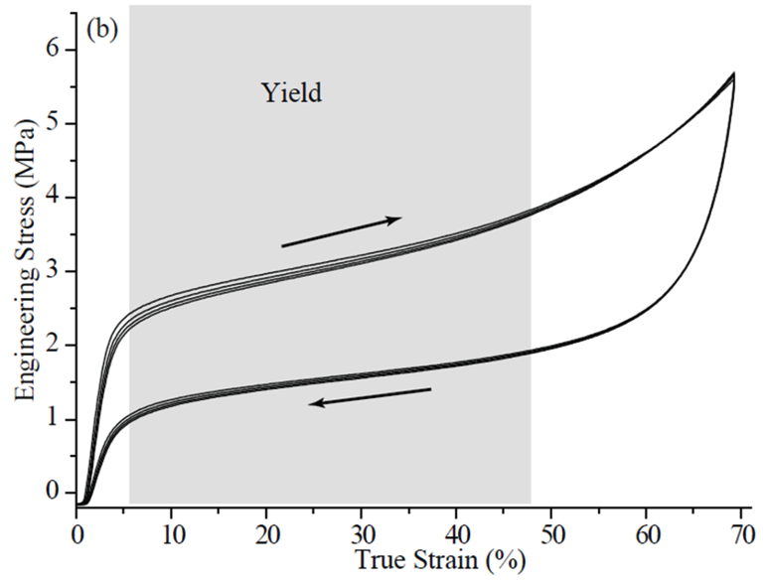
mussel
byssus
whelk egg
capsule
important yield
important yield
slow
immediate recovery
400 MPa
100 MPa
1) Stiffness
Relatively high initial stiffness
2) Extensibility
3) Recovery

Slide 3
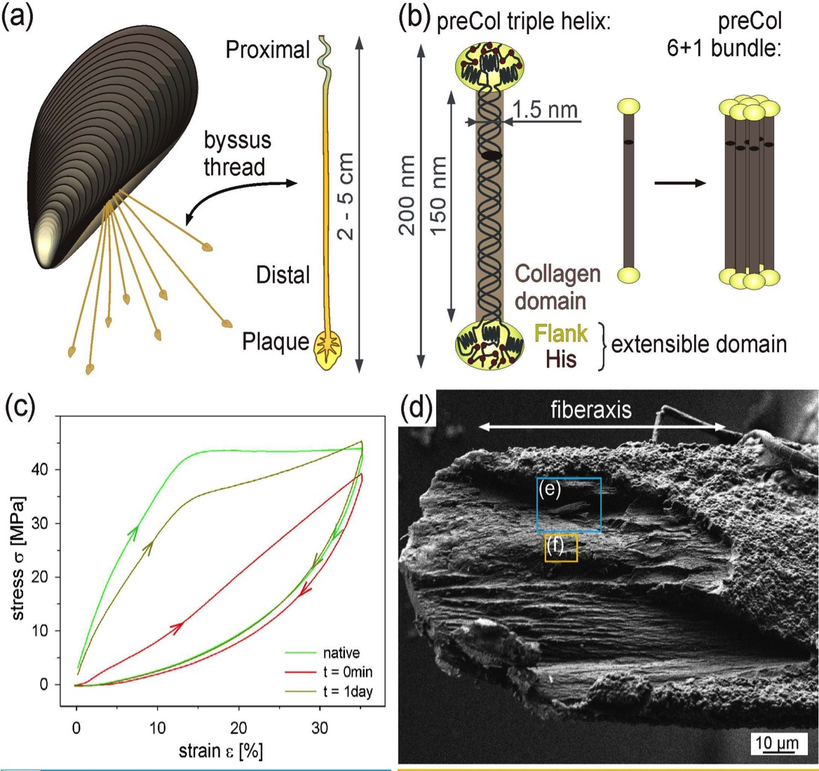

Slide 4
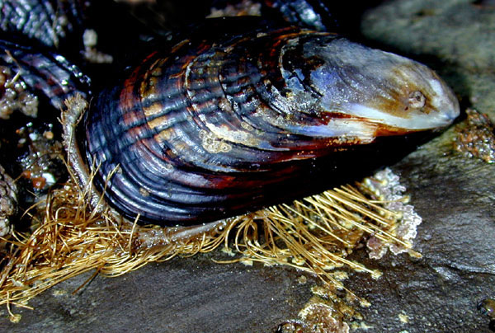
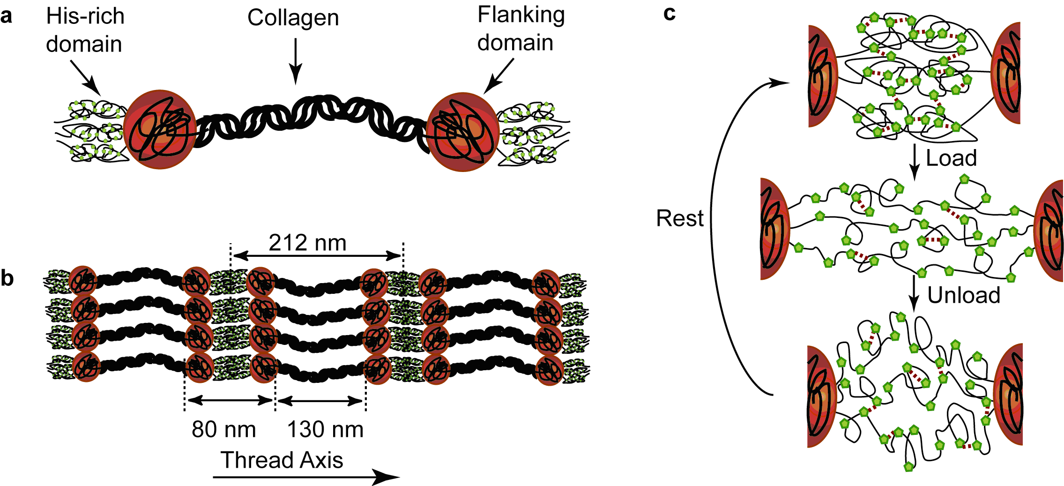
Mussel byssal threads
Self-healing fibres

Slide 5
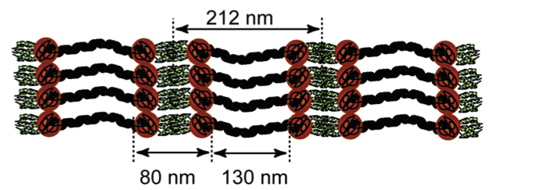
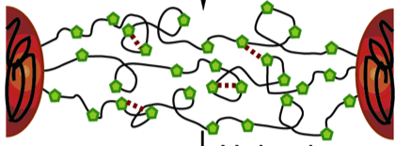
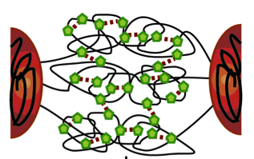
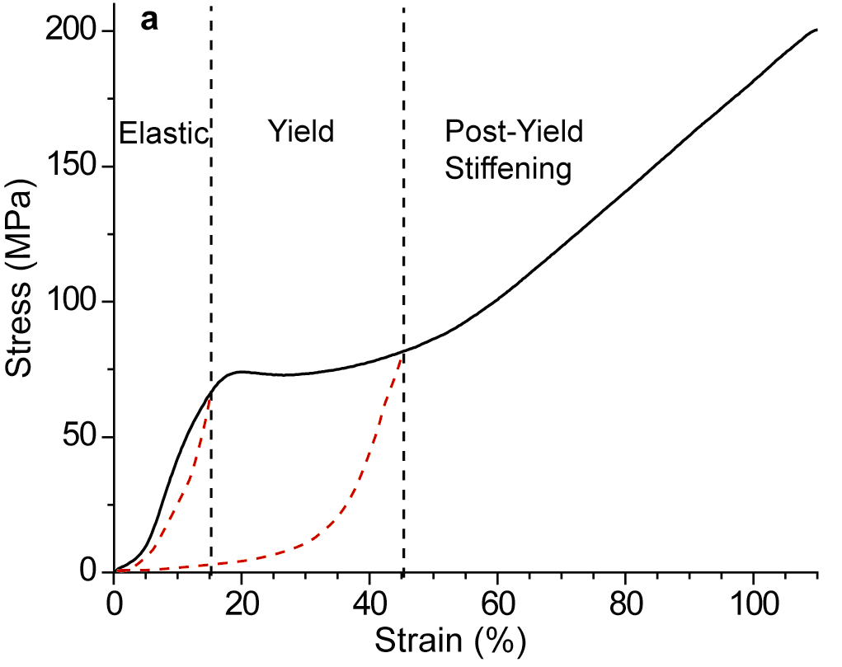
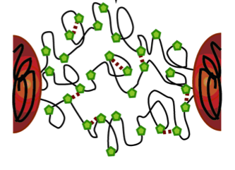
Mechanical function of Zn – Histidine bonds
yield
elastic
relaxation
„healing“ ~ 24h
1h
M. Harrington et al, 2008

Slide 6
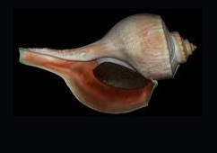
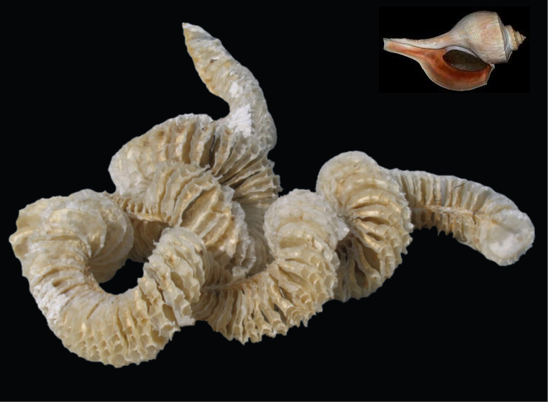

Egg capsules
of marine whelk
Busycotypus canaliculatus
Harrington et al. 2012
J Roy Soc Interface

Slide 7
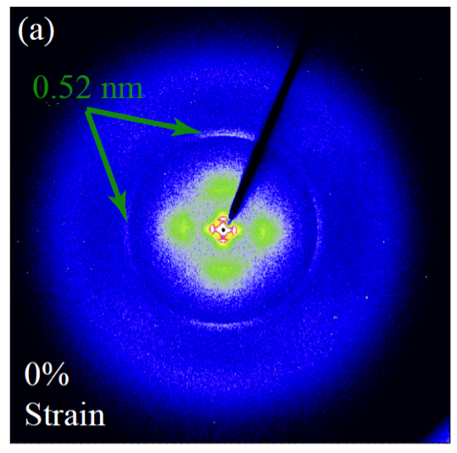
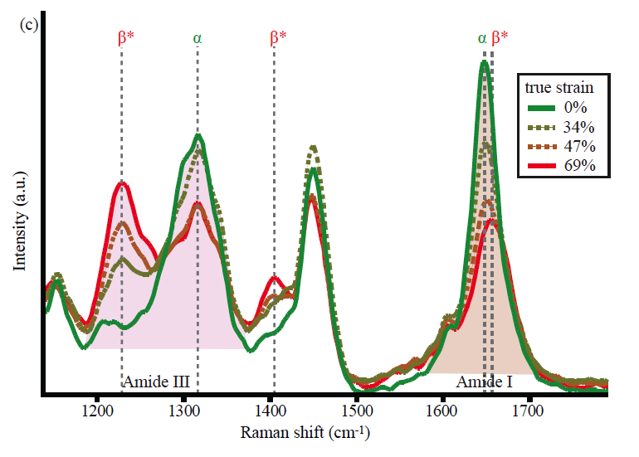
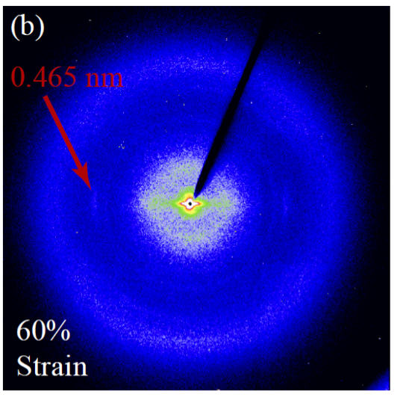
α-helix
Raman
β*
α
extended β*

Slide 8
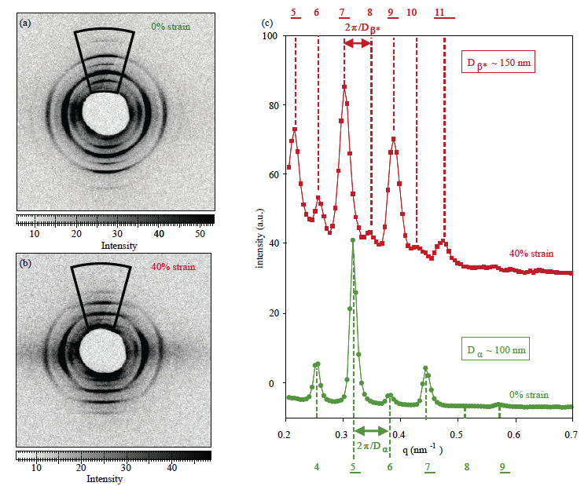
X-ray (small-angle) diffraction

Slide 9
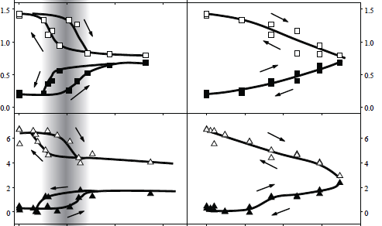
Phase coexistence
yield
Raman
intensity
XRD intensity
α
β*
stress strain

Slide 10
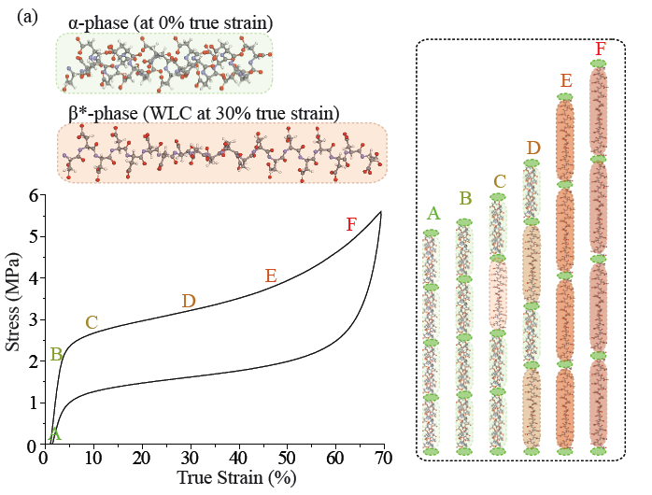
Co-existence of two phases during yield
Elastic behaviour
W(s) = (k/2) (s – s₀)²

Slide 11

Worm-like chain
(Kratky/Porod 1949)
Molecule with kinks
(Misof et al. 1998)
extended
phase
β*
Force f
actual
length
s
kink
number
ν
length
at rest
s₀
persistence
length
l_{p}
extended
(contour)
length
L
(s > s₀)

Slide 12
Relation between force and potential energy:
High strain
Low strain
WLC
kink
model
α phase (elastic)
β* phase (entropic)

Slide 13

f_{a}
All molecular segments in the fiber see the same force
mechanical equilibrium:
Complete analogy to thermodynamic equilibrium:

Slide 14
Total energy
WLC and kink model nearly
identical on this scale
internal
energy
work of
applied force
α stable stability limit α + β*
s^{c}_{low}

Slide 15
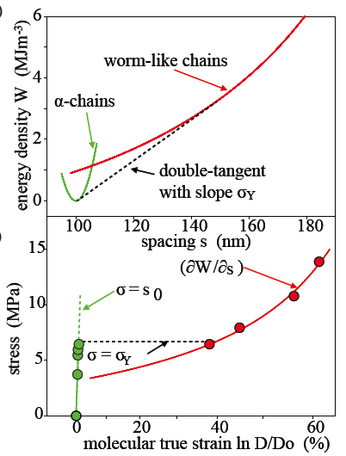

Relation to experiment
What can be measured
(by in-situ synchrotron
x-ray diffraction):
Force as a function of
mean elongation
The critical force at yield
(α-β* coexistence)
The yield point
(start of α-β* coexistence)
Reconstruct W(s)
$$σ=ρf$$
Number of molecules
per cross-sectional area

Slide 16
Phase transformation kinetics
in analogy to pseudoelasticity in NiTi
thermodynamic driving force
kinetic equation
fraction of β* segments in the fiber
Hypothesis: load at contant stress rate, (loading) and (unloading)
Based on: R. Abeyaratne, J.K. Knowles, Evolution of Phase Transitions –
A Continuum Theory (Cambridge University Press, Cambridge, 2006)

Slide 17
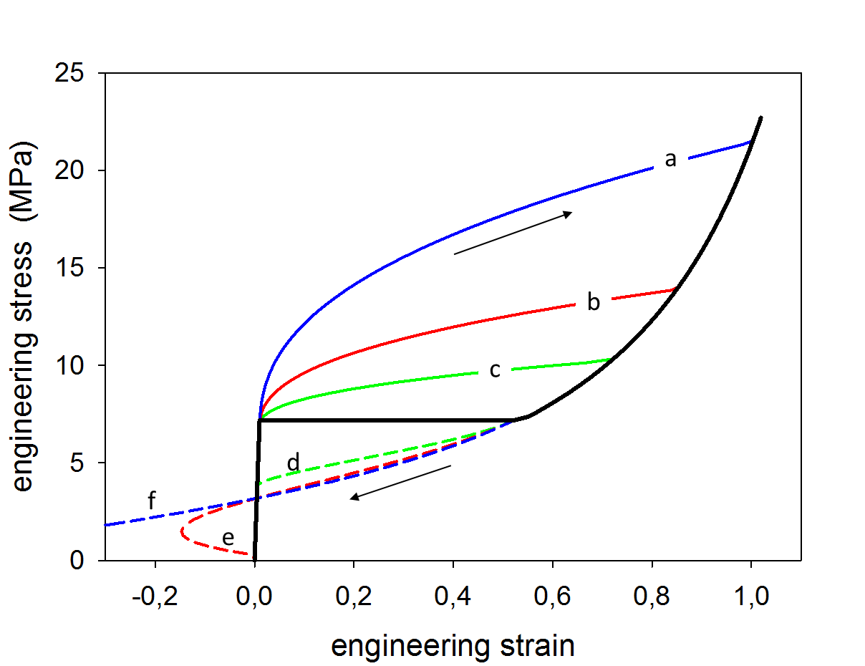
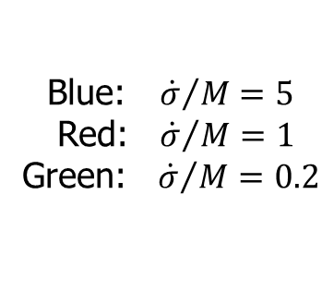
Slow or fast stretching
Blue: ${ \dot{σ}}/M=5$
Red: ${\dot{σ}}/M=1$
Green: ${\dot{σ}}/M=0.2$
WLC
Equilibrium
line

Slide 18
mussel
byssus
whelk egg
capsule
Cooperativity of many weak bonds → phase transition

