Slide 1
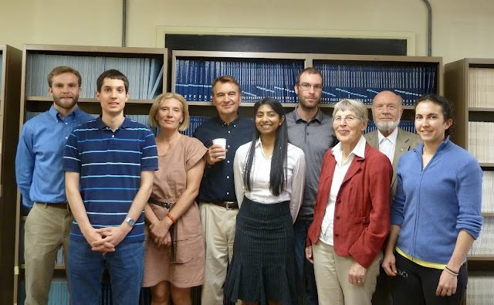
Anisimov/Sengers Research Group - 2012

Slide 2

HOW PURE WATER CAN UNMIX
Mikhail Anisimov
Institute for Physical Science &Technology and Department of Chemical & Biomolecular Engineering, University of Maryland, College Park
108th StatMech , Rutgers University December 16, 2012

Slide 3
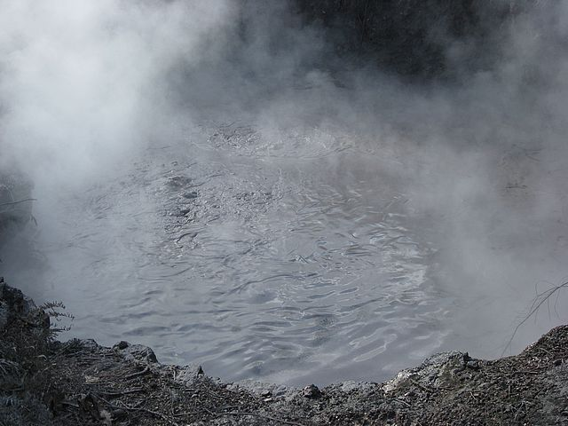
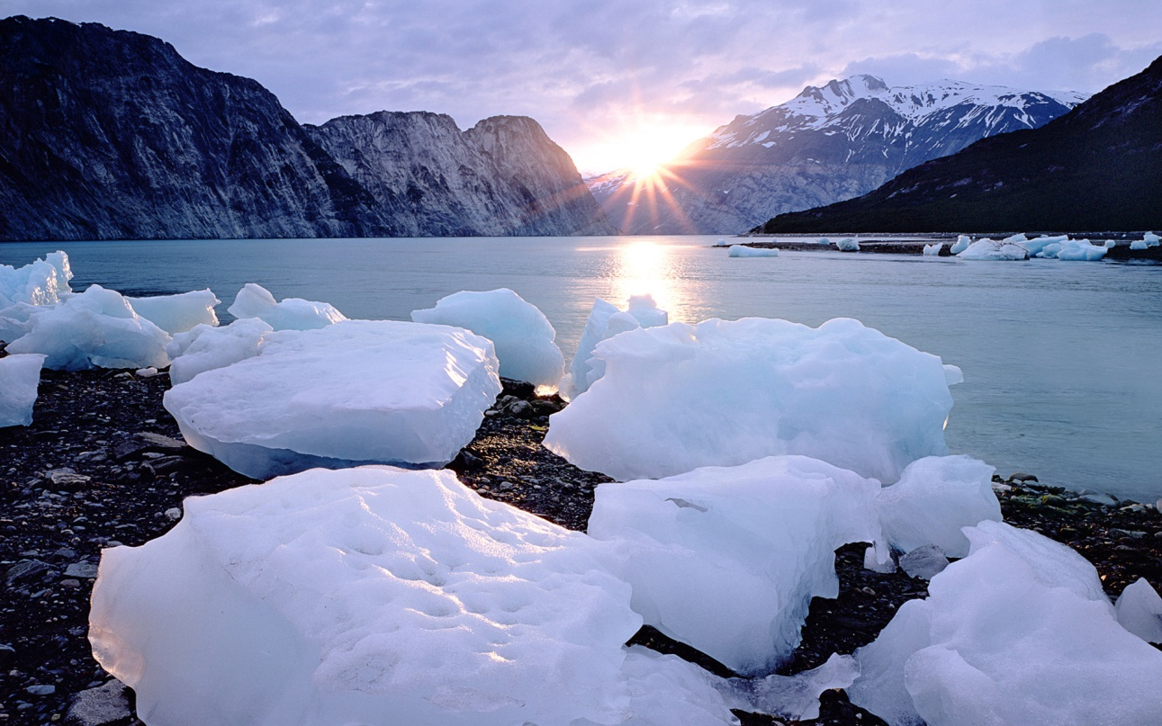
A JOURNEY FROM HOT TO COLD WATER
One Substance – Two Different Liquids

Slide 4
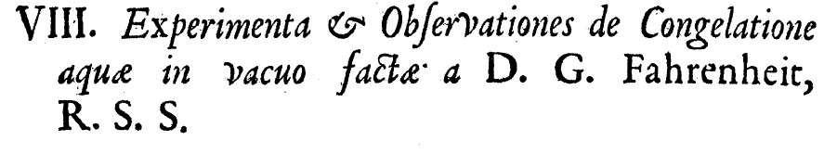
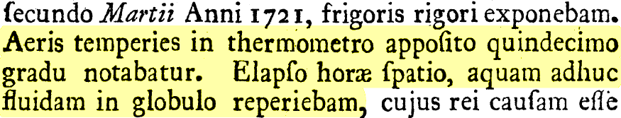
Discovery of supercooled water
Supercooled water was first described in 1721 by Fahrenheit.
The air temperature in the thermometer was marked at fifteen degrees [–9 °C ]. After one hour, I found the water was still fluid in the ball.
[D. G. Fahrenheit, Phil. Trans. 33, 78 (1724)]
Notes:
dx.doi.org/10.1098/rstl.1724.0016

Slide 5
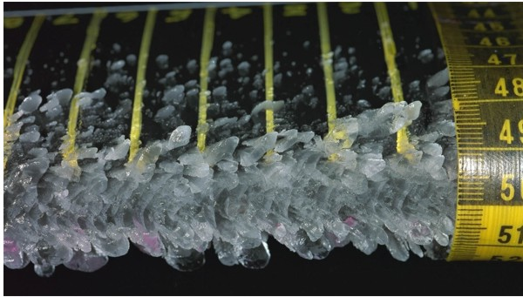
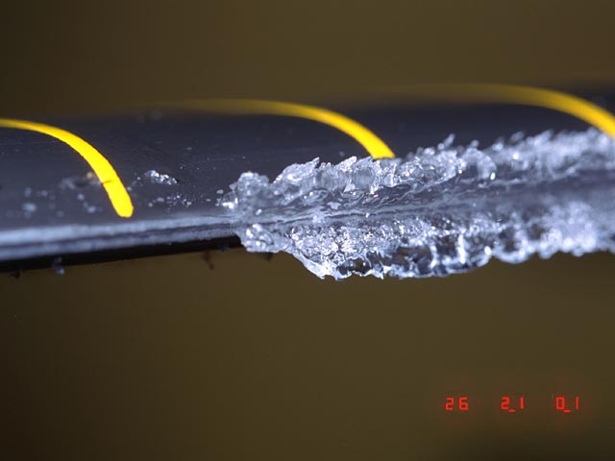
Supercooled water exists in nature
In clouds, water droplets can be liquid down to about –38 °C (–36 °F)
When an airplane flies through a supercooled water cloud, the droplets will freeze on impact: icing

Slide 6
Metastable liquid water at –90 °C
supercooled water
(metastable)
stable
liquid
water
Homogeneous
ice nucleation

Slide 7
Supercooled liquid
Stable liquid
Despretz (1837)
Hare and Sorensen (1987)

Slide 8
Water: One Substance – Two Different Liquids
High-temperature water: highly compressible, low dielectric constant, no (or little) hydrogen bonds, good solvent for organics
Low-temperature water: almost incompressible, very high dielectric constant, strong hydrogen-bond network, good solvent for electrolytes
Dielectric constant of water (IAPWS)

Slide 9
One Substance – Two Different Liquids:
Isobaric heat capacity of liquid water
Red is the prediction by our model
T_{H}
T_{M}

Slide 10
Supercooled liquid
Stable liquid
Angell et al. (1982)
Archer and Carter (2000)
HEAT CAPACITY of water UPON SUPERCOOLING
Anisimov and Voronel (1972)

Slide 11
Water’s polyamorphism:
Second (liquid-liquid) critical point in water (Poole et al. 1992)
Brown curve: liquid-liquid coexistence
Continuation is Widom line, the line of stability minima
supercooled
water
stable
water
HDL
LDL
C
At the liquid-liquid critical point C the P/T slope is 30 times greater than at the vapor-liquid critical point of water and negative
C the location of LLCP as recently suggested by Holten and Anisimov, 2012

Slide 12
Mishima’s experiment (2000)
Ice V
Ice III
stable
water
Ice I
C
O. Mishima, PRL 85, 334 (2000)
Notes:
Ice V sketched from Mishima’s 2000 article: “We have since observed another discontinuous behavior of the melting curve of H2O ice V at 75 MPa and 223 K.” Ice IV from the data Mishima sent us. Ice III sketched from D2O from Mishima’s 2000 article.

Slide 13
How can pure liquid unmix?
Energy driven: a second minimum or a special shape of the molecular interaction energy (vapor-liquid is energy driven: lattice gas, van der Waals)
Entropy driven: a “mixture” of two “states” with negative entropy of mixing (some polymer solutions, networks)
A combination of both
Clapeyron's equation itself does not answer whether the liquid-liquid separation is energy-driven or entropy driven

Slide 14
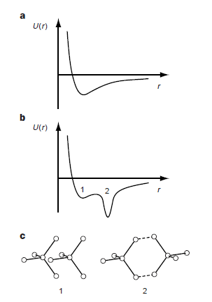
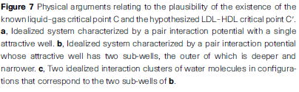
[Mishima and Stanley, Nature, 396, 329 (1998)]

Slide 15
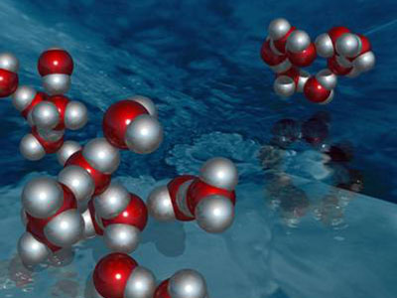
Two-State Model
A B,
Assumption: water is a nonideal “mixture” of two configurations of hydrogen bonds: high-density/high-entropy state and a low-density/low-entropy state
The fraction of each state is controlled by thermodynamic equilibrium
Liquid-liquid phase separation occurs when the non-ideality becomes strong enough

Slide 16
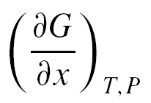
Suggested equation of state: athermal two-state model
A B
pure A and B states Gibbs energies
ideal mixing entropy contribution
non-ideal contribution
x
molecular fraction of low-density structure B. Equilibrium fraction is found from
= 0
K is chemical equilibrium constant of “reaction”
thus x is the extent of the reaction
This liquid-liquid phase separation is driven by non-ideal entropy

Slide 17
Regular-solution unmixing (energy driven) versus athermal-solution (entropy driven) unmixing
Regular solution (equivalent to lattice gas/Ising model)
Interaction parameter
Energy-driven phase separation
ω determines the critical temperature
The critical pressure is determined
by the reaction equilibrium constant:
A B,
Athermal solution
Entropy-driven phase separation
ω determines the critical pressure
The critical temperature is determined
by the reaction equilibrium constant:
A B,

Slide 18
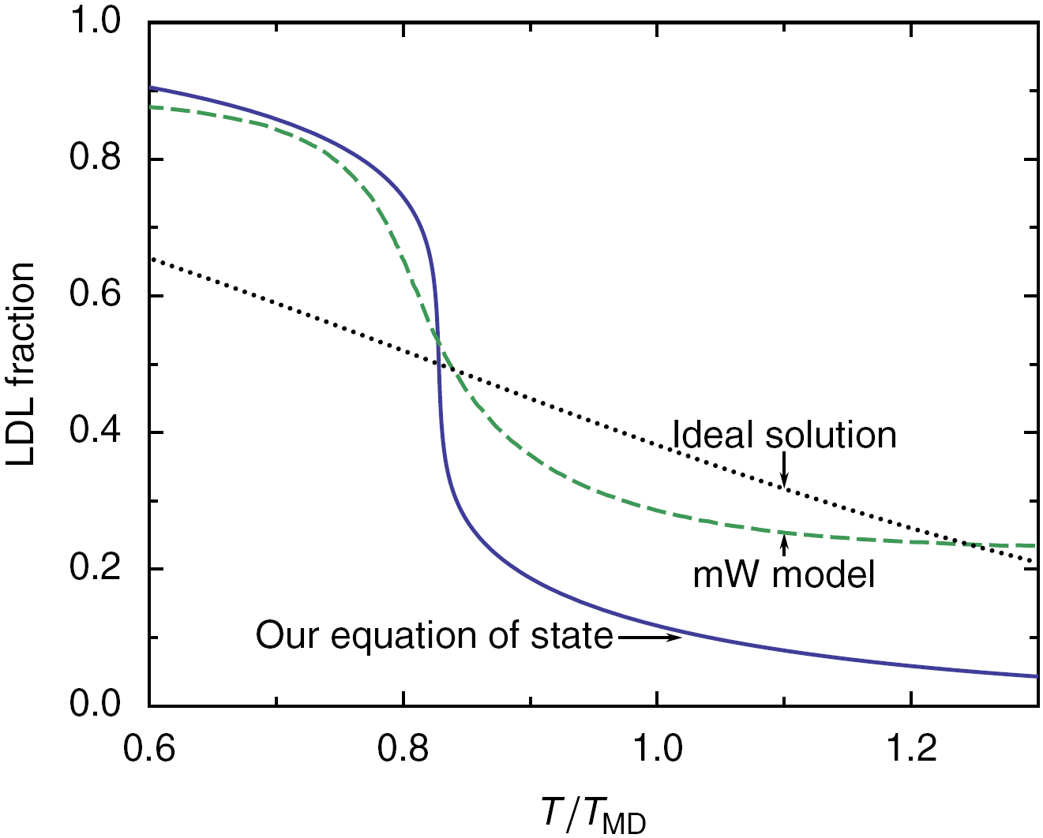
Fraction of low-density structure
x
[1]
mW model simulations: Moore and Molinero, J. Chem. Phys. 130, 244505 (2009).

Slide 19
Liquid-liquid transition is zero ordering field h₁. The order parameter is entropy change.
For liquid-gas transition the order parameter is the density change.
h₁= ln K = 0
The scaling field h₂ determines whether the transition is energy- or entropy-driven. If h₂ = ΔT, the transition is energy driven. If h₂ = -ΔP, the transition is entropy driven.

Slide 20
Heat capacity

Slide 21
Compressibility
H₂O
(melting temperatures)

Slide 22
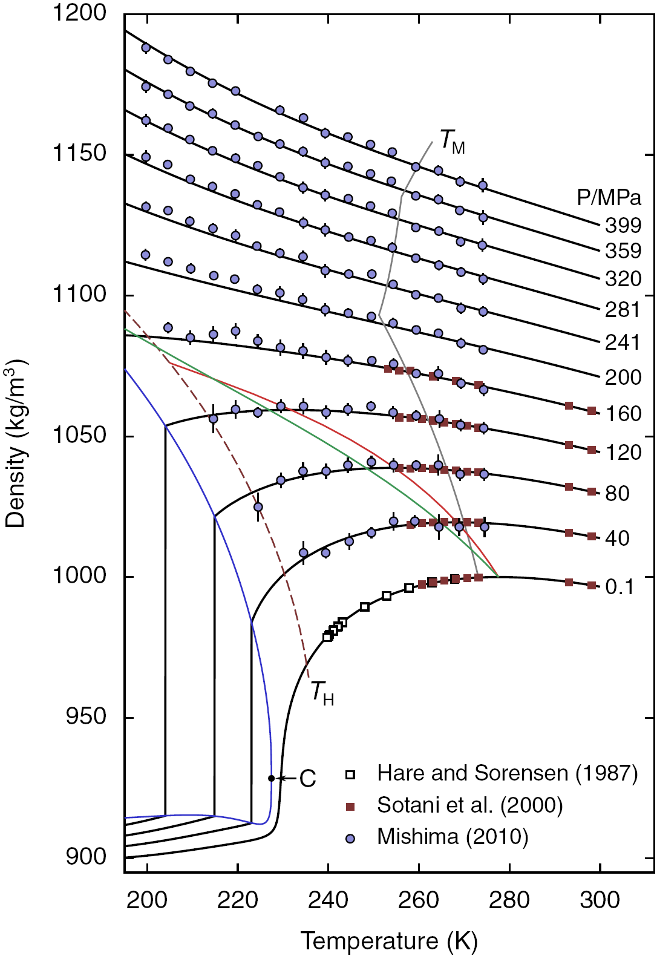
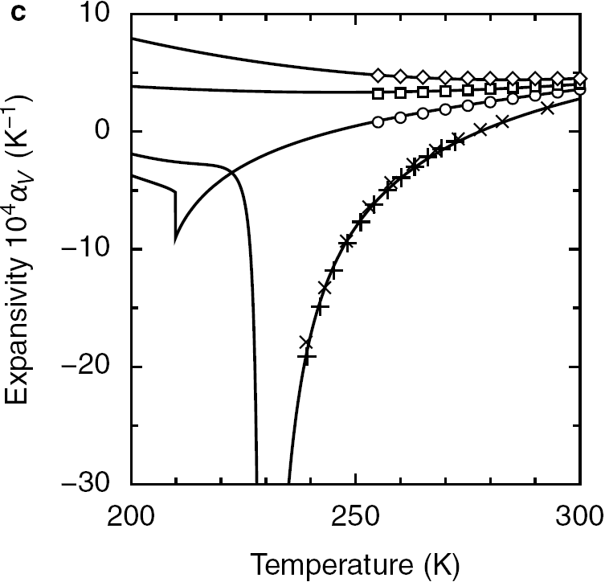
Density
380
200
100
0.1 MPa
Density of cold and supercooled water.
Black curves are the predictions of the
crossover two-state model.
T_{H} is the homogeneous nucleation
temperature. The red line is the line of
maximum density, the green line is a
constant LDL fraction of about 0.12.
Temp. of max. density
x = 0.12
Best description of all available experimental data achieved to date!
Notes:
We can describe ALL the experimental data.

Slide 23
Conclusions
We accurately describe all property data on supercooled water with a two-state model based on an athermal mixing of two states. This model assumes that the liquid-liquid transition in water is entropy driven.
Heavy water (D₂O) shows similar anomalies and can be described by our model equally well.
A regular-solution model (purely energy-driven liquid-liquid phase separation) does not work well (the description quality is an order of magnitude worse).
Current Activity
Application to atomistic models of water and to supercooled aqueous solutions.
Adding a solute to supercooled water may move the critical point into the experimentally accessible region.

