Slide 1
Honoring accomplishments of John Reppy
Superfluids and Supersolids (or not)
Harry Kojima
Rutgers
December 2012
Notes:
My honor to be speaking at this conference where we are honoring John Reppy’s accomplishments.
There is no way I can cover all of his accomplishments during this short time.
I am choosing just a few topics among his accomplishments where I had my own contributions.

Slide 2
outline
Very brief description of John Reppy’s work
  Persistent current in superfluid ⁴He
  Superfluidity of liquid ³He
  Persistent current in superfluid ³He
  Supersoldity
Torsional oscillator and ultrasound propagation in solid ⁴He

Slide 3
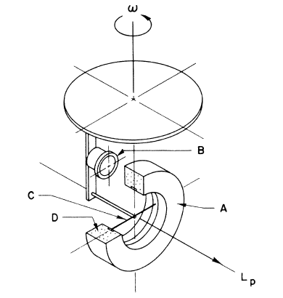
Persistent Current in Superfluid ⁴He
– superfluid gyroscope –
JD Reppy, Phys. Rev. Lett. 18, 733(1965), JD Reppy and JR Clow, Phys. Rev. A5, 424(1972).
Notes:
The most spectacular property of superfluids is the persistent current.
John Reppy did the pioneering work on measuring the properties of persistent current in superfluid He-4.
Persistent current is created in this torus and therefore a persistent angular momentum.
Rotating the system around this axis induces a torque around this horizontal axis and this changes the capacitance between the torus and the fixed electrode.
Precision measurements could be made for the first time and the system was used to study critical velocity near lambda point and loagarithm decays.

Slide 4
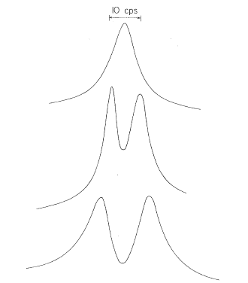
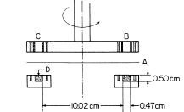
Detection of persistent current
– Doppler-shifted fourth sound –
fourth sound amplitude
4th sound in annulus
f (Hz)
I Rudnick, HK, W Veith and R Kagiwada, Phys. Rev. Lett. 23, 1220(1969).
Notes:
My contribution as a graduate student to the physics of persistent current is to study it by fourth sound.
The idea of late Izzy Rudnick was to measure the Doppler shift caused by persistent current and produces splitting of fourth sound.

Slide 5
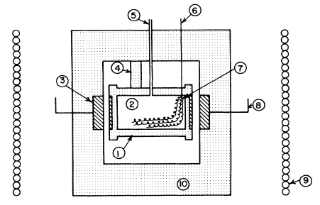
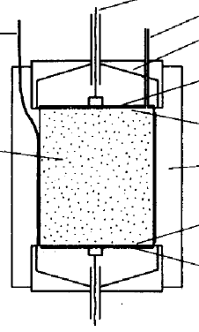
New Phase of Liquid ³He
– fourth sound propagation and superfluidity –
AW Yanof and JD Reppy, Phys. Rev. Lett. 33, 631(1974)
4th sound cell by HK et al.
Notes:
Next experiment I wish to discuss is John Reppy’s experiment on the superfluidity of He-3.
I mentioned fourth sound already, but it propagates only if the working fluid is a superfluid.
If fourth sound propagates, the fluid under study is a superfluid.
Detected

Slide 6
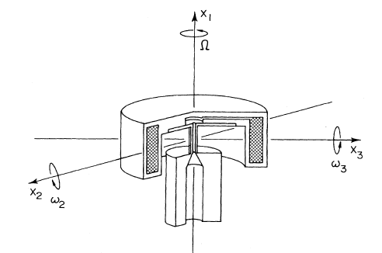
Persistent Current in Superfluid ³He
– ac gyroscope at mK –
PL Gammel, HE Hall and JD Reppy, Phys. Rev. Lett. 52, 121(1984)

Slide 7
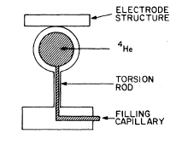
Search for Supersolidity in ⁴He
– torsional oscillator with exquisite sensitivity –
D. Bishop, M.A. Paalanen, J.D. Reppy, “Search for superfluidity in hcp ⁴He,” Phy. Rev. B 24, 2844(1981).
Abstract: We have measured the moment of inertia of hcp ⁴He crystals from 25 mK to 2 K. With a precision of five parts in 10⁶ we find no evidence for a nonclassical rotational inertia. This indicates that if a supersolid exists, it has a ρ_{s}/ρ of less than 5 × 10⁻⁶, a transition temperature of less than 25 mK, or a critical velocity of less than 5 μm/sec.
idea:
Spherical sample chamber is filled with solid ⁴He.
The sample chamber is attached to torsion rod.
Torsional oscillation frequency depends on k and I.
I comes from the container and sample.
If part of sample loses contact with the container, or becomes superfluid, torsional oscillation frequency increases.

Slide 8
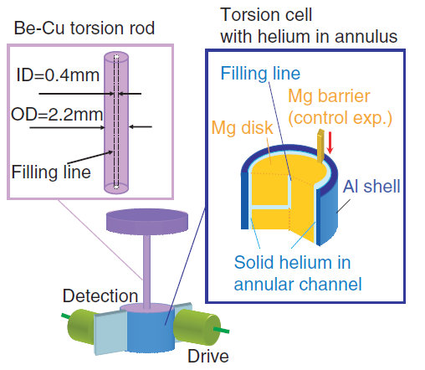
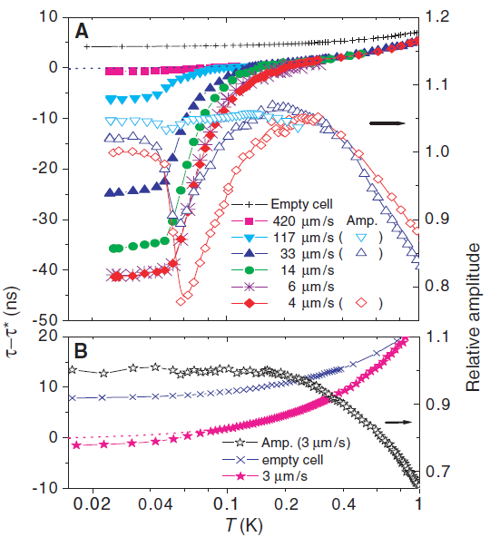
Evidence for Supersolidity
– TO experiment –
E. Kim and M. Chan, “Observation of Superflow in Solid Helium,” Science 305, 1941(2004).
Notes:
20 odd some years later, Eunsung Kim and Mose Chan discovered that bulk solid He-4 did show the decoupling effect in their torsional oscillator experiments.
Some of you may have read in Physics Today that supersolidity is slipping away. That article dealt mainly with solid He-4 in nano-porous Vycore material. I guess Moses will be discussing this on Monday.
Decoupling between bulk solid He-4 and torsional oscillator body was reported in this paper.
Origin of this observation has not yet been clarified to my knowledge.

Slide 9
Search for Independent Evidence of Supersolidity
– fourth sound propagation –
Motivation: If two fluid model applies to supersolidity, there should be a slow fourth-sound-like propagation consistent with measured superfluid fraction (0.1 – 1 %).
current
generator
amp
solid He
scope
heater
Bolometer (Ti film “superconducting transition edge detector”)
Result: Thermally excited phonon propagation could be seen but no fourth-sound-like propagating mode.
Y Aoki, X Lin and HK, Low T Phys. 34, 329(2008).
Notes:
1 Is there another experiment that can show supersolidity?
2 Just as with liquid He-3, our first thought was to search for fourth sound propagation which would occur only in a superfluid.
3 This viewgraph shows a schematic of our experiment. The idea was to apply a pulse of heat on one end of the sample and to see if a fourth sound like propagation occurs in the temperature range where TO indicated mechanical decoupling.
No obvious fourth-sound like signal could be detected.
Perhaps this was due to insufficient sensitivity of the bolometer we used.

Slide 10
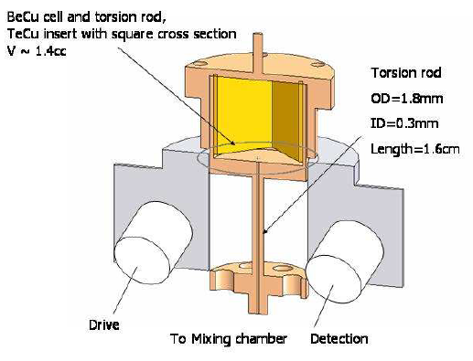
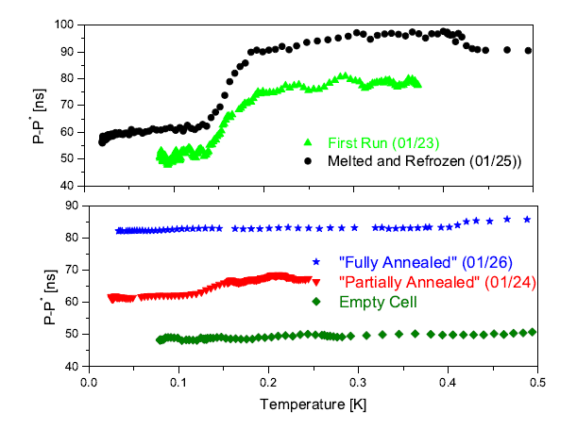
Material Physics of “Supersolidity”
– annealing –
ASC Rittner and JD Reppy, Phys. Rev. Lett. 97, 165301(2006).
Annealing effect is seen in many experiments but not in all.
Results: sample defects and disorder are important. This motivated our next experiment.
Notes:
In the meantime, John uncovered an important aspect of this supersoldity.
Frequency shift observed in the TO experiments can be strongly affected by annealing of the sample.
This experiment was important in showing that some defects in the sample might be important in the observation of supersolidity.

Slide 11
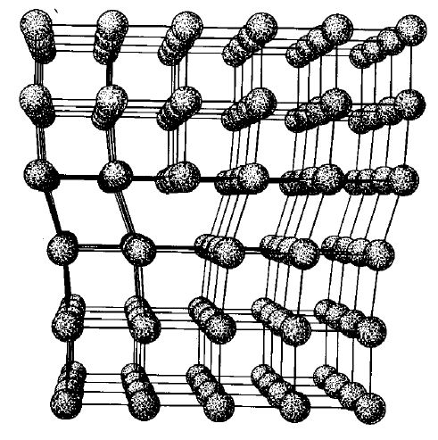
Combine Torsional Oscillator with Ultrasound
Motivated by Rittner&Reppy result on the importance of defects and disorder
Important defect in hcp solid ⁴He: dislocation lines. Role of dislocation lines in supersolidity as seen by TO??
Edge dislocation line
Dislocation lines are pinned at network nodes and by impurities
Lines act like stretched strings (Granato-Lucke theory)
Sound propagation interact with the strings – ultrasound range to match
Both propagation velocity and attenuation are affected.
Search for correlation between ultrasound and TO effect.
slip plane
Notes:
We were motivated by the Rittner-Reppy work to look for correlation between defects in the sample and TO.
Important defects in hcp solid He-4 are dislocation lines.
Edge dislocation lines can be visualized as an extra plane of atoms wedge between perfect crystal planes.
Dislocation line here runs into the paper within the so-called slip plane.
It is called slip-plane because of the ease with which the lines move in the plane.
The dislocation lines are not totally free to move. They are pinned at “network nodes” where dislocation lines intersect.
The distance between the nodes is of the order of microns.
It turns out ultrasound is sensitive to the dislocation lines since its wavelength is close to the dislocation lengths.
Granato-Lucke theory was developed to see how the dislocation line motion interacts with ultrasound propagation.
The presence of dislocation lines affect both the propagation velocity and attenuation.

Slide 12
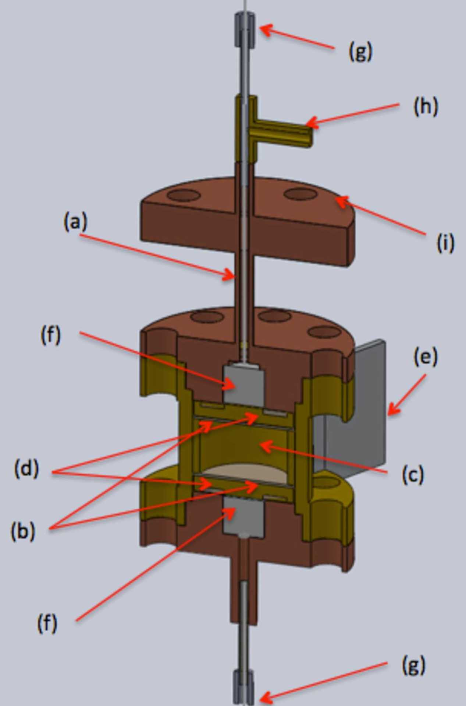
Simultaneous ultrasound and torsional oscillation
– experimental set up –
torsion rod
Mounting flange to dilution refrigerator
sample chamber
10 MHz quartz transducers
Notes:
Build an experimental cell to measure both the ultrasound and TO simultaneously as shown here.
Torsion rod is here and the sample chamber is cylindrical. The torsion frequency is 1 kHz.
The sample chamber is fitted with a pair of quartz transducers tune to 10 MHz.
We track both TO response and ultrasound propagation simultaneouly.

Slide 13
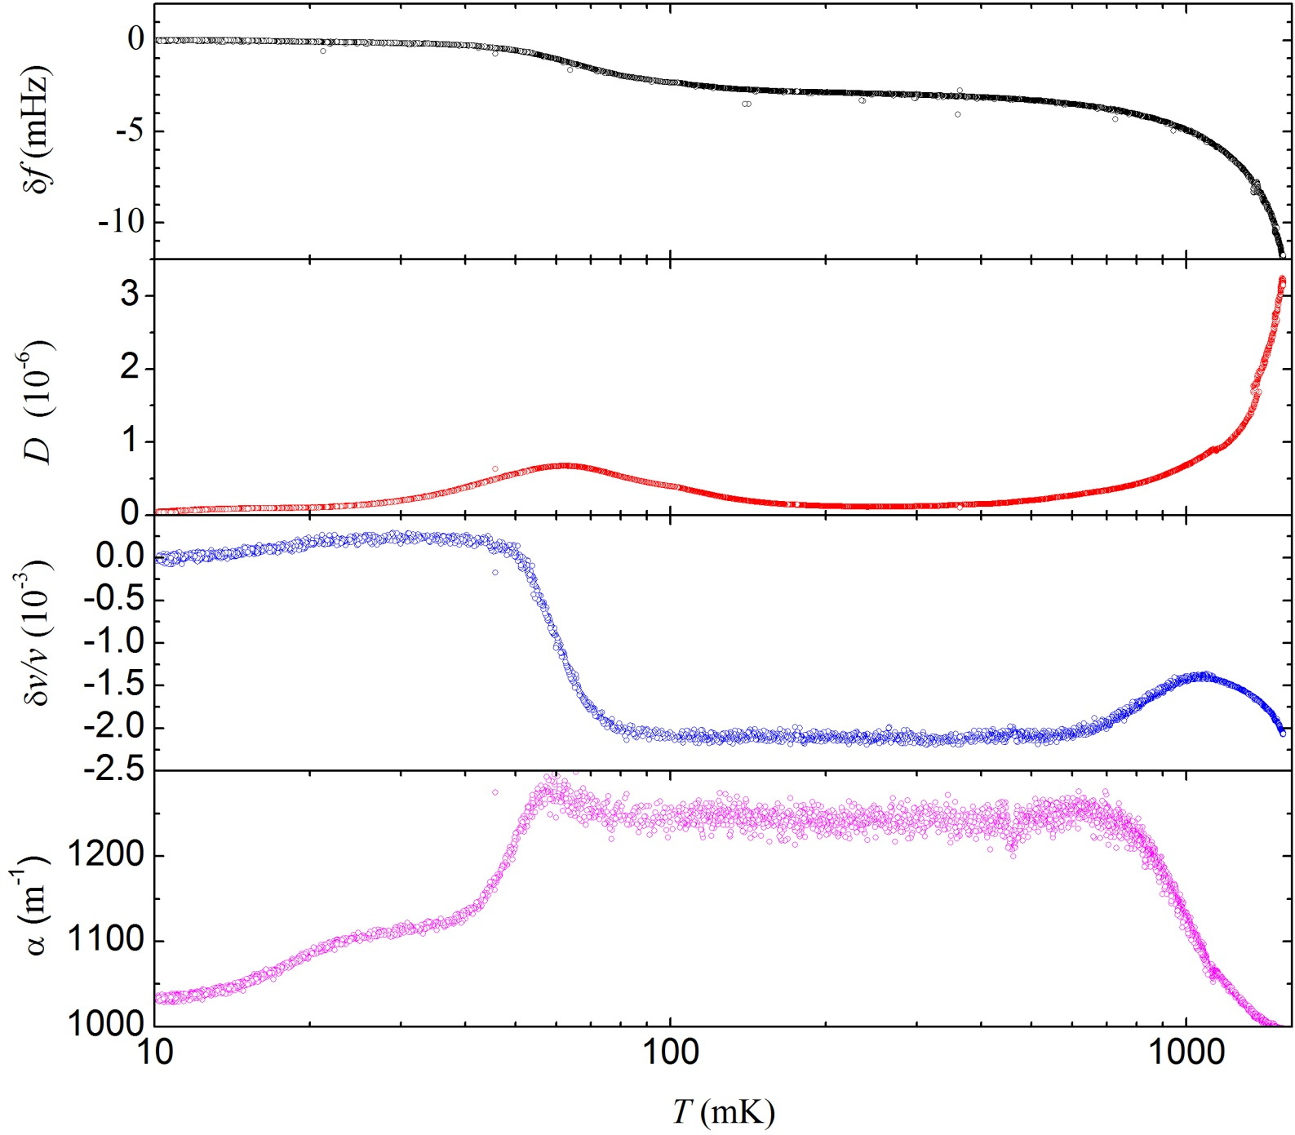
nom. high purity ⁴He with 0.3 ppm ³He impurity
Notes:
Results of one sample are shown. Note the temperature scale is shown in log.
Frequency shift and dissipation peak are clearly seen similar to other experiments. The dissipation peak occurs at about 70 mK.
Changes in ultrasound velocity and attenuation show interesting behavior.
Above 1 K, effects of dislocation lines are not significant owing to the large associated dissipation at high temperatures. In this range, data can be described by the interaction of the ultrasound with thermally excited phonons.
Below 1 K, dislocation lines are expected to influence the ultrasound significantly.
These data are very recent and have not been analyzed fully using the Granato-Lucke theory.
Interesting features of the ultrasound data are the those near 70 mK. This temperature appears to coincide with that of TO features.

Slide 14
Simultaneous ultrasound and torsional oscillation
– preliminary interpretations –
High T (T > 1 K)
  Ultrasound: phonon anharmonic effects
  TO: similar to other experiments
Intermediate T (0.3 < T < 1 K)
  Ultrasound: effects of dislocations are expected to be important
Low T (T < 0.3 K)
  TO: increase in f – decoupling effect(?), peak in dissipation
  Ultrasound: corresponding changes
Effects of annealing
Effects of adding ³He impurity
Notes:
I have discussed the first three items here.
What happens if the sample is annealed?
Going back to the previous slide, the amount of TO frequency shift decreases but does not disappear.
The ultrasound features sharpen up.
What happens if He-3 impurity level is increased?

Slide 15
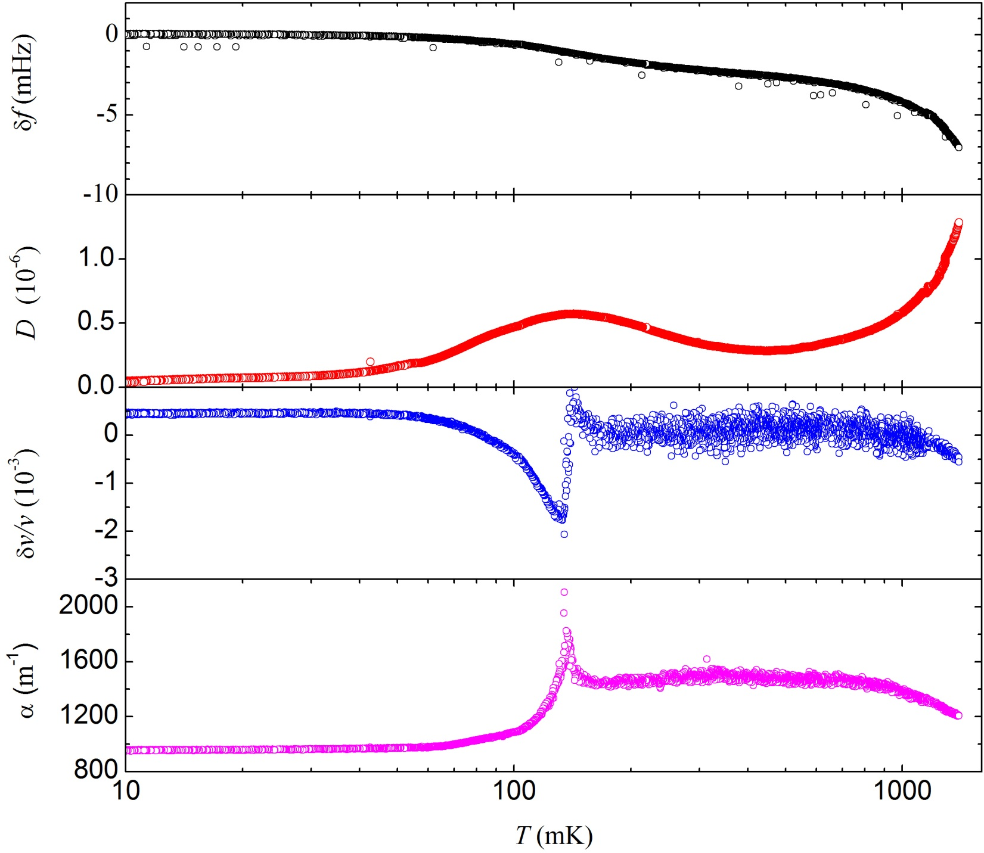
sample with nom. 20 ppm ³He annealed at 1.55 K
Notes:
Added abut 20 ppm of He-3 impurity. Grew a sample as usual and then annealed at 1.5 K for 24 hours.
Note that the shift in TO frequency is decreased from the high purity sample.
The center of TO effect has shifted to higher temperature near 140 mK as seen by the dissipation peak.
Note that the features in the ultrasound are sharp and also shift by about the same amount.
The low temperature features in TO and ultrasound track each other.
It would be difficult to explain the sharp features in ultrasound with dislocation line motion theory.
These remind those anomalies found the John Goodkind some 15 years ago. They were interpreted as some phase transition taking place. We’ll still have to see if we are seeing the same effect.

Slide 16
conclusions
Simultaneous ultrasound and torsional oscillator measurements on solid ⁴He
High purity sample with 0.3 ppm ³He
  TO data show frequency increase at T < 0.3 K and dissipation peak near 80 mK
  Ultrasound changes in propagation velocity and attenuation around 80 mK
Sample with 20 ppm ³He impurity
  TO f shift and dissipation move to higher T
  Ultrasound velocity and attenuation also move to same higher T
TO and ultrasound show correlated effects. Evidence for both being due to dislocation line motion.

