Slide 1


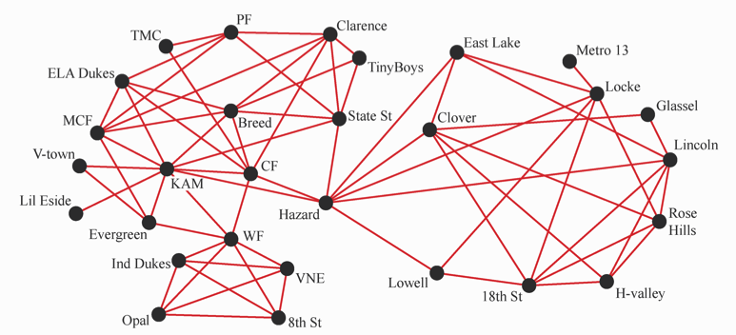


Data clustering, modularity optimization, and total variation on graphs
Andrea Bertozzi
University of California, Los Angeles
Thanks to Arjuna Flenner, Ekaterina Merkurjev, Tijana Kostic, Huiyi Hu, Allon Percus, Mason Porter, Thomas Laurent

Slide 2
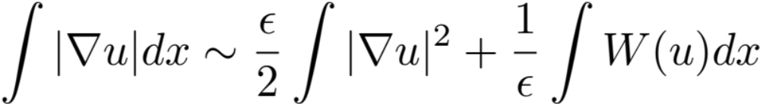
Diffuse interface methods
Total variation
Ginzburg-Landau functional
W is a double well potential with two minima
Total variation measures length of boundary between two constant regions.
GL energy is a diffuse interface approximation of TV for binary functionals
There exist fast algorithms to minimize TV – 100 times faster today than ten years ago

Slide 3


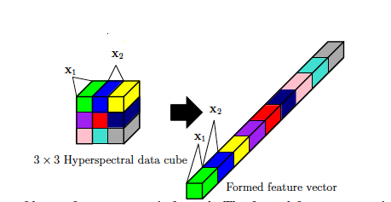
Weighted graphs for “big data”
In a typical application we have data supported on the graph, possibly high dimensional. The above weights represent comparison of the data.
Examples include:
voting records of Congress – each person has a vote vector associated with them.
Nonlocal means image processing – each pixel has a pixel neighborhood that can be compared with nearby and far away pixels.

Slide 4
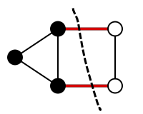
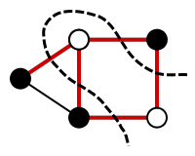
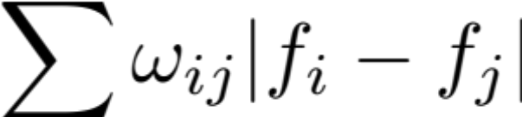
Graph Cuts and Total Variation
Mimal cut
Maximum cut
Total Variation of function f defined on nodes of a weighted graph:
Min cut problems can be reformulated as a total variation minimization problem
for binary/multivalued functions defined on the nodes of the graph.

Slide 5
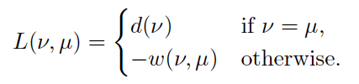
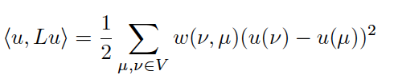

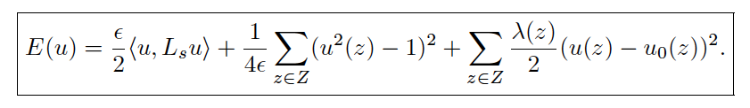
Diffuse interface methods on graphs
Bertozzi and Flenner MMS 2012.

Slide 6



Convergence of graph GL functional
van Gennip and ALB Adv. Diff. Eq. 2012

Slide 7
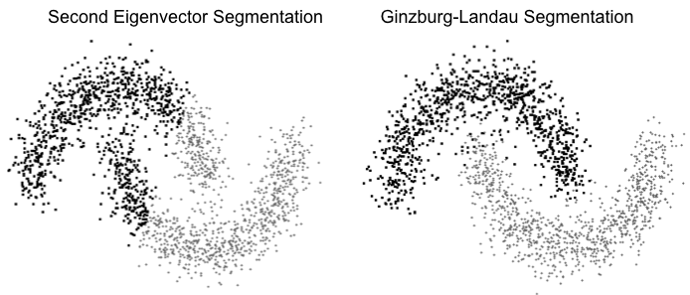
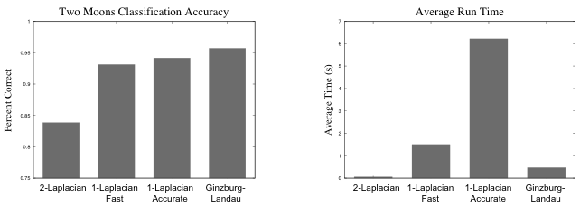
Diffuse interfaces on graphs
ALB and Flenner MMS 2012
Replaces Laplace operator with a weighted graph Laplacian in the
Ginzburg Landau Functional
Allows for segmentation using L1-like metrics due to connection with GL
Comparison with Hein-Buehler 1-Laplacian
2010.

Slide 8
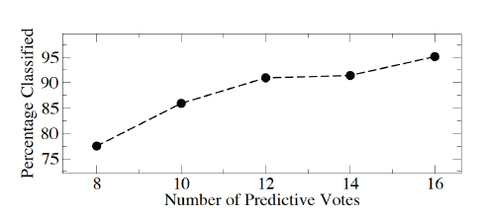
US House of Representatives voting Record classification of party affiliation from voting record
98th US Congress 1984
Assume knowledge of party affiliation of 5 of the 435 members of the House
Infer party affiliation of the remaining 430 members from voting records
Gaussian similarity weight matrix for vector of votes (1, 0, -1)

Slide 9
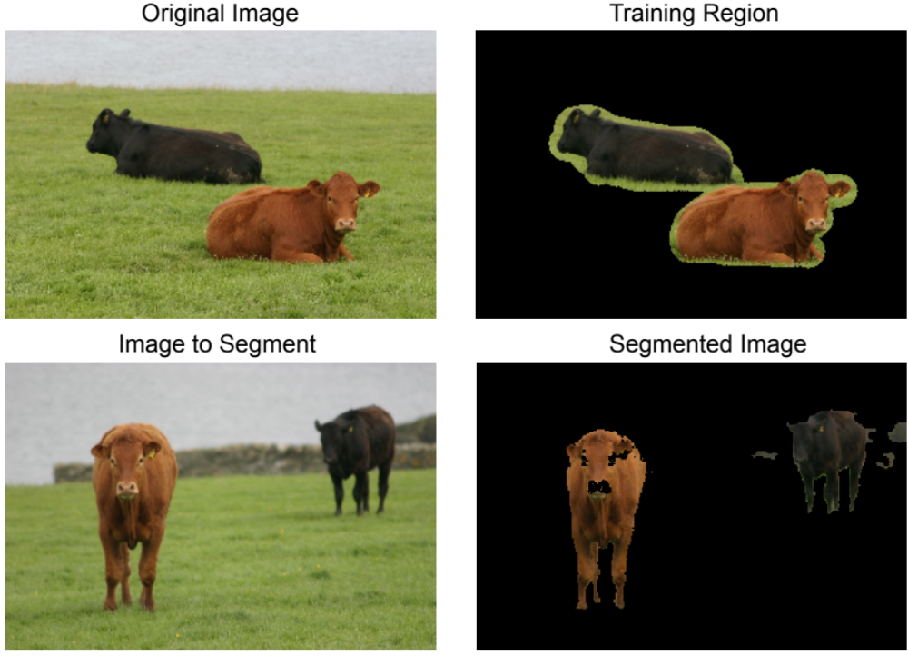
Machine learning identification of similar regions in images
High dimensional fully connected graph – use Nystrom extension methods for fast computation methods.

Slide 10
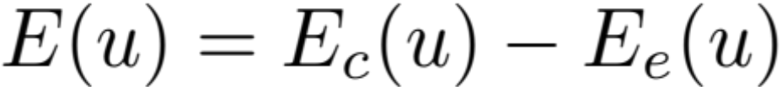
Convex Splitting Schemes
Basic idea:
Project onto Eigenfunctions of the gradient (first variation) operator
For the GL functional the operator is the graph Laplacian

Slide 11

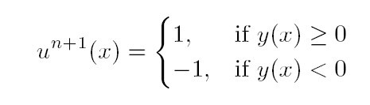
An MBO scheme on graphs for segmentation and image processing
E. Merkurjev, T. Kostic and A.L. Bertozzi, submitted to SIAM J. Imaging Sci
1) propagation by graph heat equation + forcing term
2) thresholding
Simple! And often converges in just a few iterations (e.g. 4 for MNIST dataset)

Slide 12
Algorithm
I) Create a graph from the data, choose a weight function and then create the symmetric graph Laplacian.
II) Calculate the eigenvectors and eigenvalues of the symmetric graph Laplacian. It is only necessary to calculate a portion of the eigenvectors*.
III) Initialize u.
IV) Iterate the two-step scheme described above until a stopping criterion is satisfied.
*Fast linear algebra routines are necessary – either Raleigh-Chebyshev procedure or Nystrom extension.

Slide 13
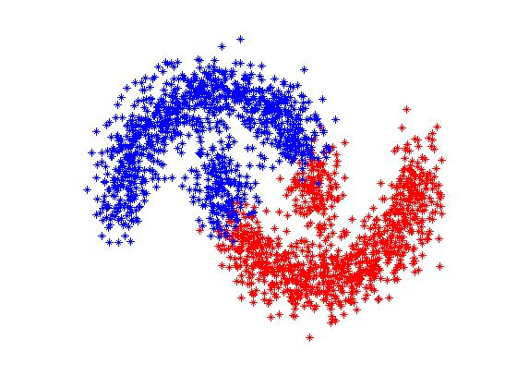
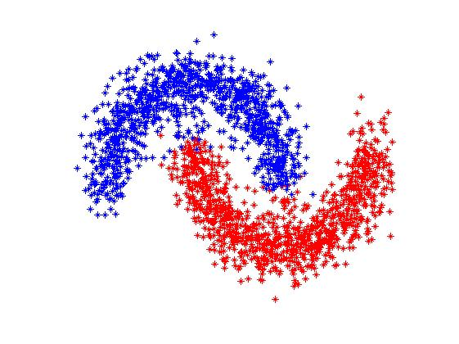
Two Moons Segmentation
Second eigenvector segmentation
Our method’s segmentation

Slide 14
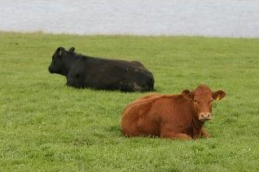
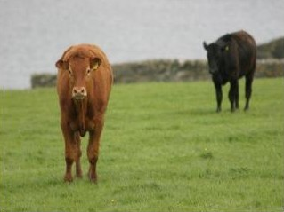
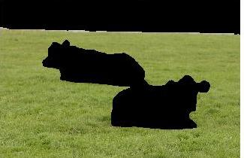
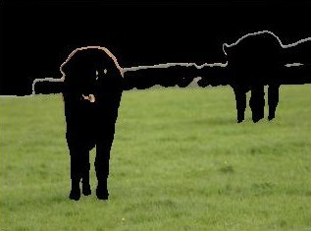
Image segementation
Original image 1
Original image 2
Handlabeled grass region
Grass label transferred

Slide 15
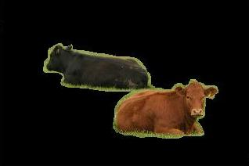
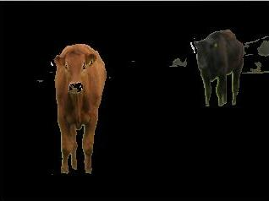
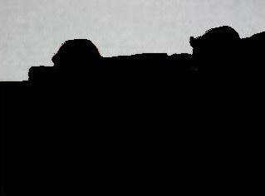

Image Segmentation
Handlabeled cow region
Cow label transferred
Handlabeled sky region
Sky label transferred

Slide 16
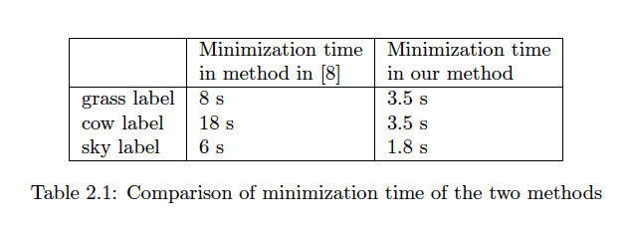
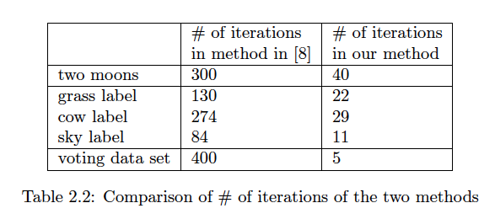
Bertozzi-Flenner vs MBO on graphs

Slide 17
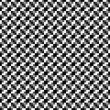
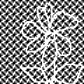
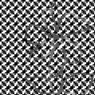
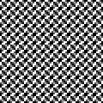
Examples on image inpainting
Original image
Damaged image
Local TV inpainting
Nonlocal TV inpainting
Our method’s result

Slide 18
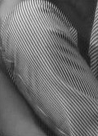
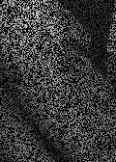
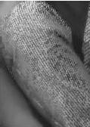
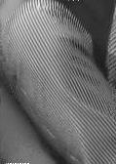
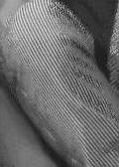
Sparse Reconstruction
Original image
Damaged image
Local TV inpainting
Nonlocal TV inpainting
Our method’s result

Slide 19
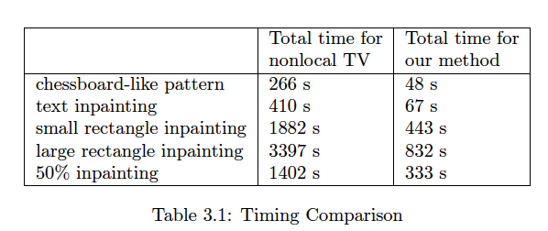
Performance NLTV vs MBO on Graphs

Slide 20

Convergence and Energy Landscape for Cheeger Cut Clustering
Bresson, Laurent, Uminsky, von Brecht (current and former postdocs of our group), NIPS 2012
Relaxed continuous Cheeger cut problem (unsupervised)
Ratio of TV term to balance term.
Prove convergence of two algorithms based on CS ideas
Provides a rigorous connection between graph TV and cut problems.

Slide 21
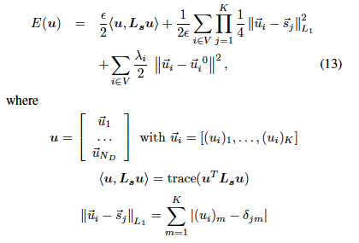
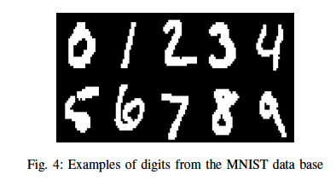
Generalization MULTICLASS Machine Learning Problems (MBO)
Garcia, Merkurjev, Bertozzi, Percus, Flenner, 2013
Semi-supervised learning
Instead of double well we have N-class well with
Minima on a simplex in N-dimensions

Slide 22
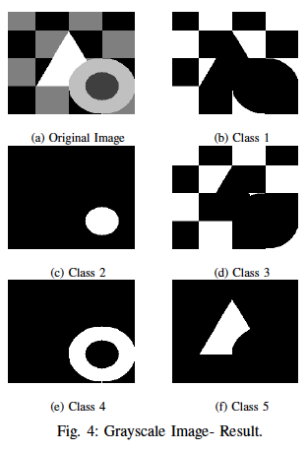
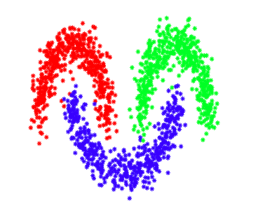
Multiclass examples – semi-supervised
Three moons MBO Scheme 98.5% correct.
5% ground truth used for fidelity.
Greyscale image 4% random points for fidelity, perfect classification.

Slide 23
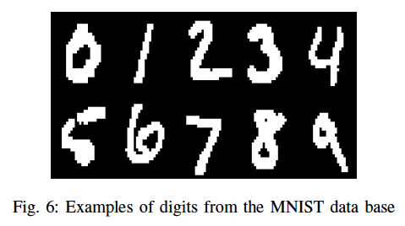
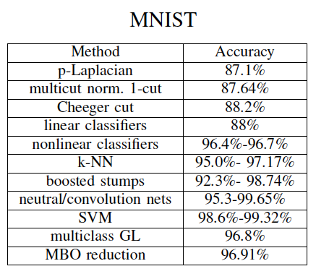
MNIST Database
Comparisons
Semi-supervised learning
Vs Supervised learning
We do semi-supervised with
only 3.6% of the digits as the
Known data.
Supervised uses 60000 digits for training and tests on 10000 digits.

Slide 24
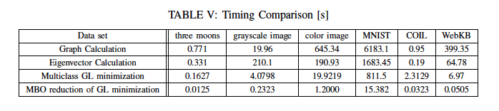
Timing comparisons

Slide 25
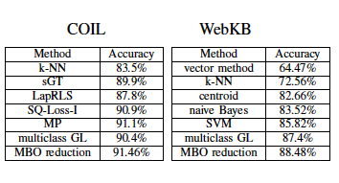
Performance on Coil WebKB

Slide 26

Community Detection – modularity Optimization
Joint work with Huiyi Hu, Thomas Laurent, and Mason Porter
Newman, Girvan, Phys. Rev. E 2004.
[w_{ij}] is graph adjacency matrix
P is probability nullmodel (Newman-Girvan) P_{ij}=k_{i}k_{j}/2m
k_{i} = sum_{j} w_{ij} (strength of the node)
Gamma is the resolution parameter
g_{i} is group assignment
2m is total volume of the graph = sum_{i} k_{i} = sum_{ij} w_{ij}
This is an optimization (max) problem. Combinatorially complex – optimize over all possible group assignments. Very expensive computationally.

Slide 27


Bipartition of a graph- reformulation as a TV minimization problem (using graph cuts)
Given a subset A of nodes on the graph define
Vol(A) = sum _{i in A} k_{i}
Then maximizing Q is equivalent to minimizing
Given a binary function on the graph f taking values +1, -1 define A to be the set where f=1, we can define:

Slide 28


Connection to L1 compressive sensing
Thus modularity optimization restricted to two
groups is equivalent to
This generalizes to n class optimization quite naturally
Because the TV minimization problem involves functions with values on the simplex we can directly use the MBO scheme to solve this problem.

Slide 29
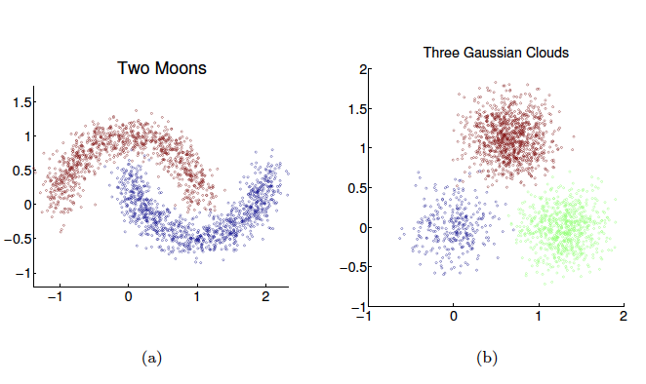
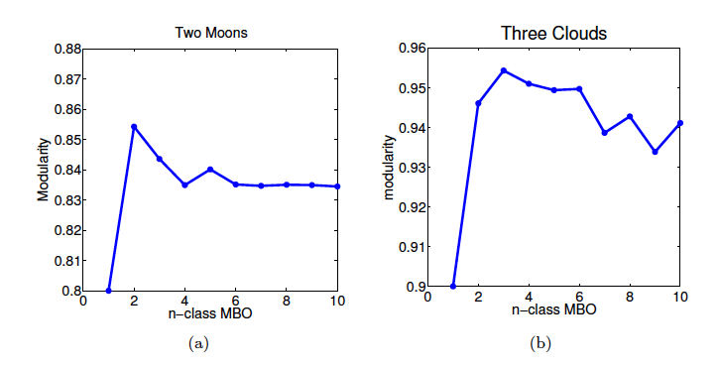
Modularity optimization moons and clouds

Slide 30

LFR Benchmark – synthetic benchmark graphs
Lancichinetti, Fortunato, and Radicchi Phys Rev. E 78(4) 2008.
Each mode is assigned a degree from a powerlaw distribution with power ξ.
Maximum degree is kmax and mean degree by <k>. Community sizes follow a powerlaw distribution with power beta subject to a constraint that the sum of of the community sizes equals the number of nodes N. Each node shares a fraction 1-μ of edges with nodes in its own community and a fraction μ with nodes in other communities (mixing parameter). Min and max community sizes are also specified.

Slide 31
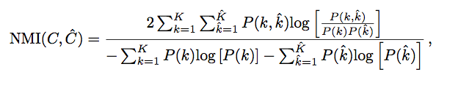

Normalized Mutual information
Similarity measure for comparing two partitions based on information entropy.
NMI = 1 when two partitions are identical and is expected to be zero when they are independent.
For an N-node network with two partitions

Slide 32
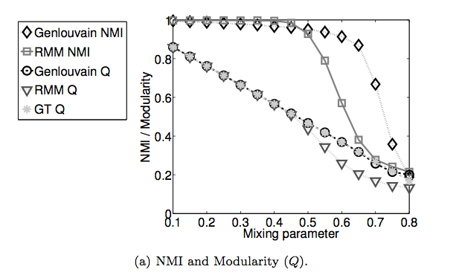
LFR1K(1000,20,50,2,1,mu,10,50)

Slide 33
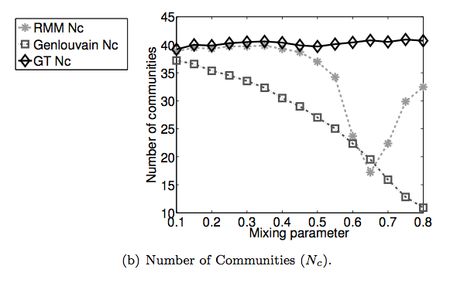
LFR1K(1000,20,50,2,1,mu,10,50)

Slide 34
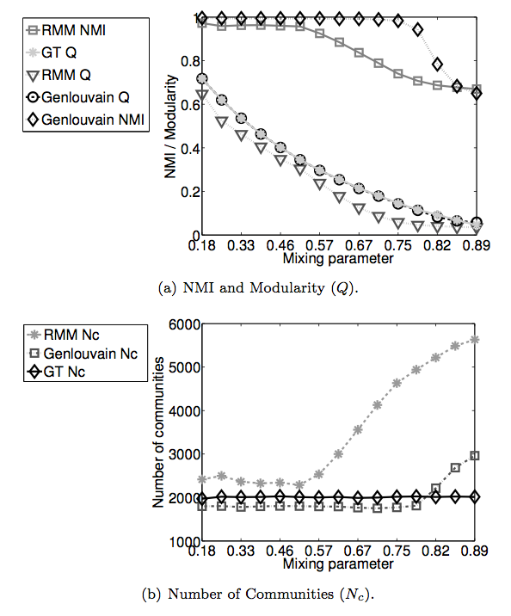

LFR50k
Similar scaling to LFR1K
50,000 nodes
Approximately 2000 communities
Run times for LFR1K and 50K

Slide 35

MNIST 4-9 digit segmentation
13782 handwritten digits. Graph created based on similarity score
between each digit. Weighted graph with 194816 connections.
Modularity MBO performs comparably to Genlouvain but in about a
tenth the run time. Advantage of MBO based scheme will be for
very large datasets with moderate numbers of clusters.

Slide 36

4-9 MNIST Segmentation

Slide 37
Cluster group at ICERM spring 2014
People working on the boundary between compressive sensing methods and graph/machine learning problems
February 2014 (month long working group)
Workshop to be organized
Looking for more core participants

