Slide 1
Response Surfaces of Gene Networks
Killian Ryan
Lars Seemann
Alexander Mo
Jason Shulman
Gregg Roman, Biology

Slide 2
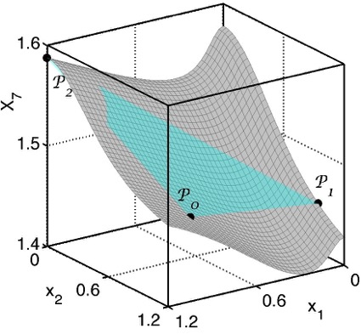
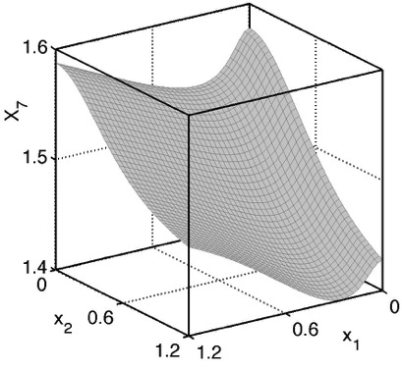
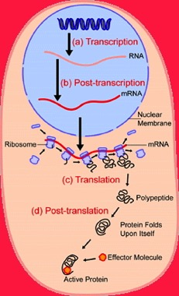
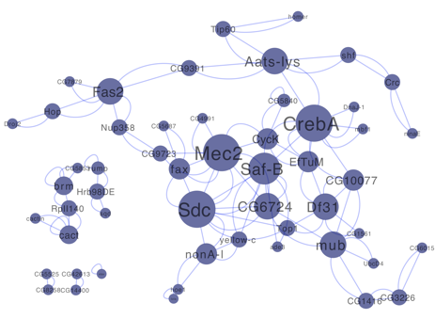
Overview
Cellular state changes upon differentiation, course of disease, during sleep-wake cycle, etc.
Can we alter the state?
Response surfaces
  Can be obtained experimentally
  are smooth
  ➔ compute how to alter the cellular state

Slide 3
Altering the Cellular State
Fibroblasts ➔ iPSC: Oct3/4, Sox2, c-Myc, Klf4
(Takahashi and Yamanaka, 2006)
Fibroblasts ➔ cardiomyocytes: Gata4, Mef2c, Tbx5
  (Ieda et al., 2010)
Pancreatic cells ➔functional β cells: Neurogenin3, Pdx1, Mafa
(Baeyens et al., 2005)
Fibroblasts ➔liver cells: Gata4, Hnf1 , Foxa3, p17^{Arf}
(Huang et al., 2011)
Fibroblasts ➔ neurons: Ascl1, Brn2, Myt1l
(Vierbuchen et al., 2010)
The biomolecules used are Transcription Factors
Groups are identified by analyzing all possibly relevant TFs, individually and in combination
Experiments are done in culture; conversion rates are low
Optimal level of up/down-regulation is not known
Modifying biological processes?

Slide 4
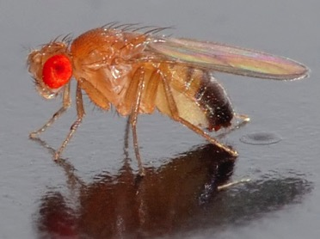
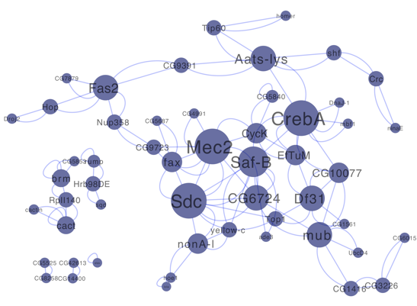
Sleep Deprivation in Drosophila (Zimmermann et.al., 2006)
Traumatic
Quantifiable behavioral changes:
  Shorter sleep latency
  Longer sleep
  Increased arousal threshold
  Lower associative learning
There is a homeostatic network to prevent trauma
Genetics: up/down regulates 159 genes
Goal
  Genetically move the head transcriptome to a sleep-deprived-like state
Control only a set of “master” nodes; e.g., transcription factors

Slide 5

Alter a State with “Master” Nodes
master nodes?
Level of up/down regulation?
If so ➔reduced dimensionality
Defines response surfaces

Slide 6
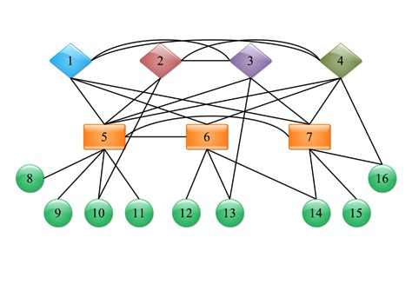
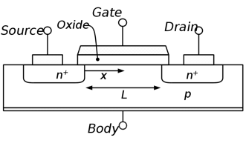
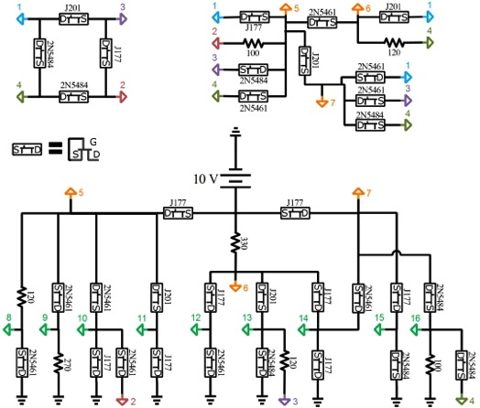
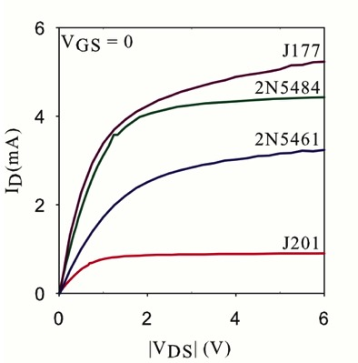
Example: Nonlinear Electrical Circuit
Gene levels ➔ Node potentials
Interactions ➔ currents
Knockout ➔ Ground the node

Slide 7

Formulation
Master Variables: {X₁, X₂, X₃, X₄}
Slaved Variables: {x₅, x₆,…...., x₁₆}

Slide 8
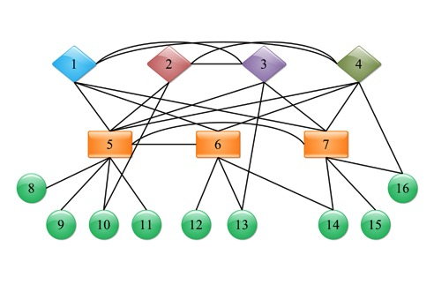
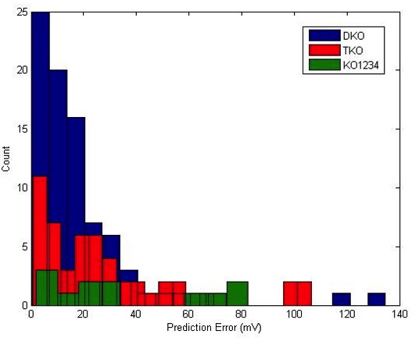
Quantitative Validation
Differences between surface and plane: mean=22 mV; max=89 mV
Double knockouts: mean=20 mV
Triple KOs: mean=28 mV;

Slide 9
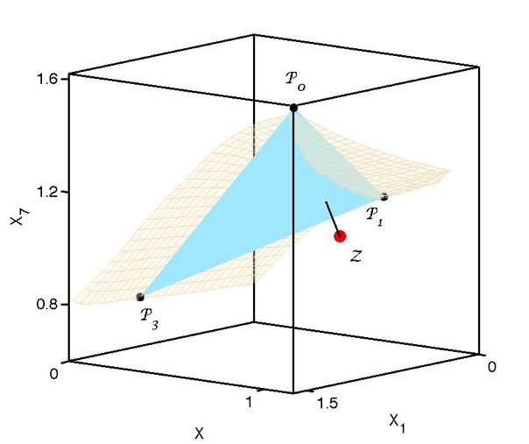


Altering the State
Externally set the master nodes to the values defined by the projection of X(λ)
Network will change the slave nodes

Slide 10
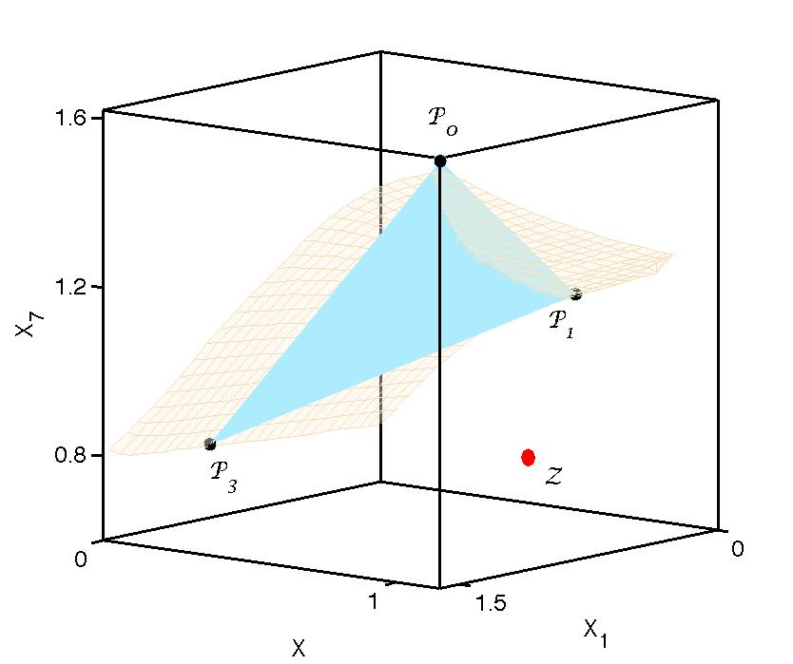
If Z is Far from the Response Surface
Expand the set of the master nodes
Additional nodes k are selected to be those for which U(λ,w) is small when w_{k}=0

Slide 11
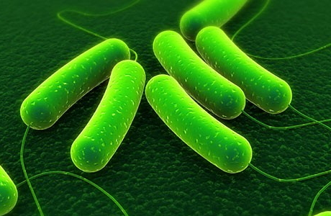

Application: O₂-Deprivation Network of E.coli
(Covert, Knight, Reed, Hergaard, Palsson, 2004)
Gene Ontology ➔ O₂-deprivation network: 284 genes
WT + 5 SKOs ➔ 5D planar approximation
Expression levels of the DKO and all organisms in anaerobic conditions can be predicted
~90% predictions are within 95% confidence level

Slide 12
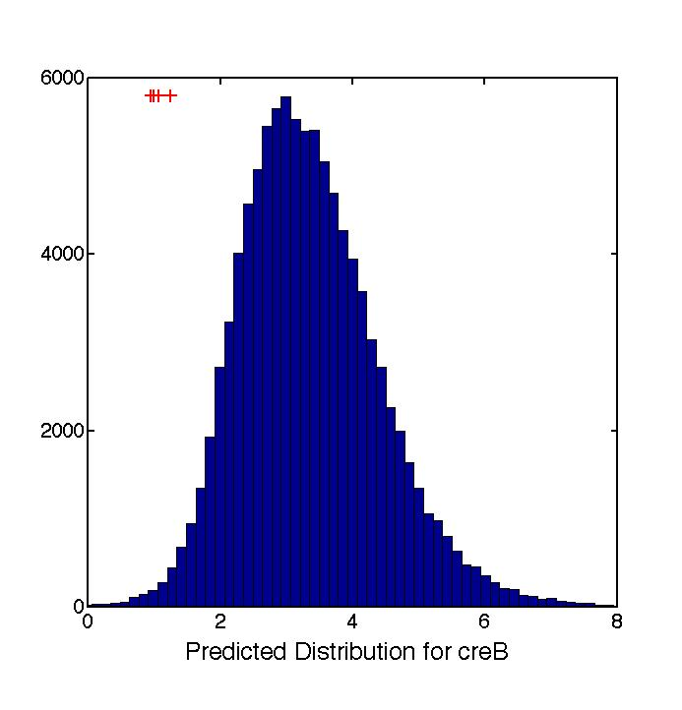
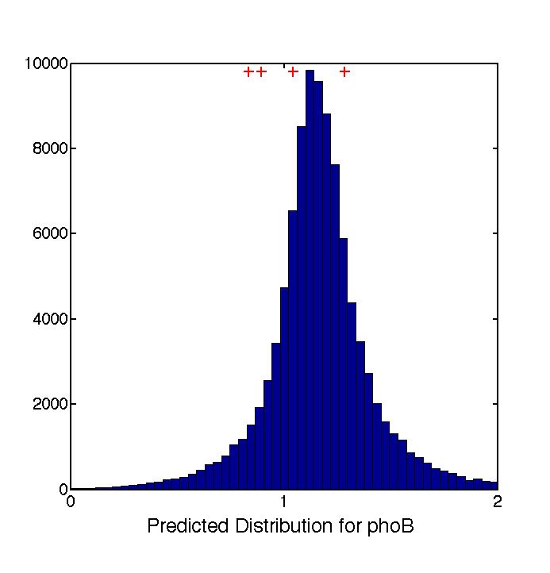
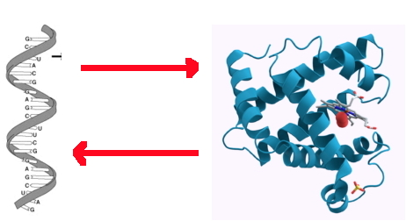
Application: O₂-Deprivation Network of E.coli
Feed forward loop ➔ bistability

Slide 13
Application: DREAM5 Network Interference Challenge
Wild-type and mutant data for a synthetic network are given
Challenge: Find the network
We use WT, g49, and g169 mutant data to predict expression levels of DKO g49g169
~90% predictions are within 95% confidence level

Slide 14

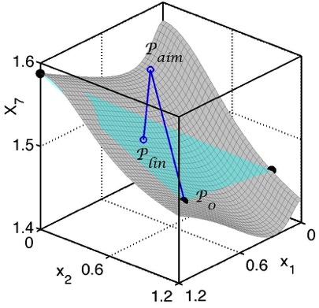


Conclusions
Response surfaces ➔ infer how cellular states can be altered
Methodology ➔ periodically driven (circadian) networks
Sleep deprivation studies are in progress
Other studies: addiction, autism
More efficient conversion of fibroblasts ➔ iPSC ?

Slide 15
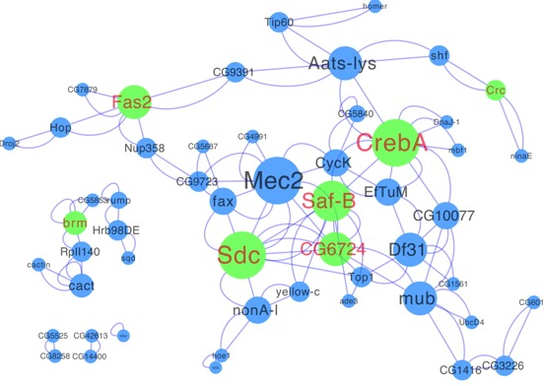
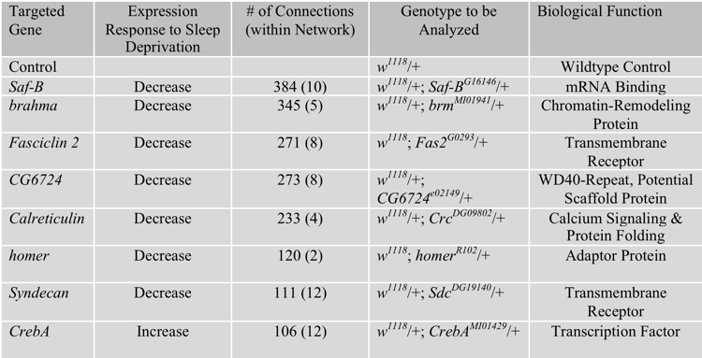
Putting Flies to Sleep: Genetics
Move from Normal ➔ Sleep Deprived state
increase: pan-neural elav-Gene switch
decrease: UAS-RNAi transgenes

Slide 16
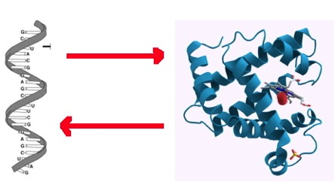

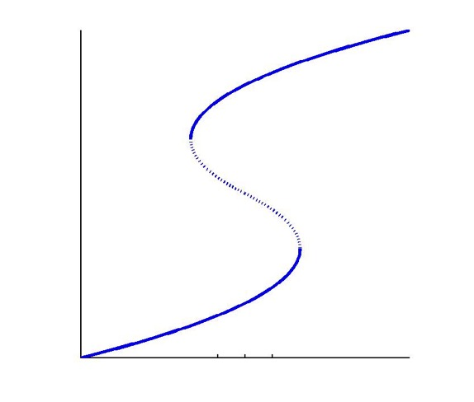
Bistability

Slide 17
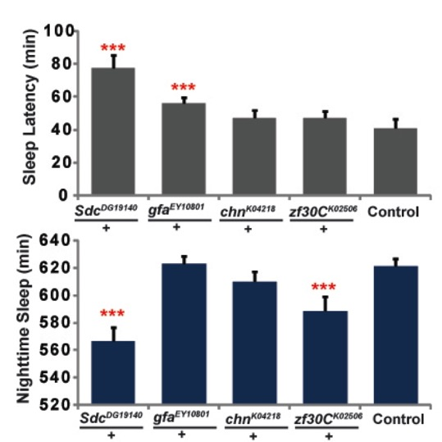
Sleep Homeostatis: Behavior
Move from Normal ➔ Sleep Deprived state
Compare behavioral features
- longer sleep
- sleep latency
- arousal threshold
- associative learning

Slide 18
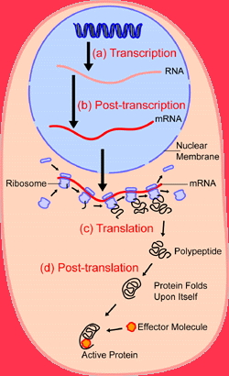
Selecting Master Nodes

Slide 19
Publications
G.H. Gunaratne, P.H. Gunaratne, L. Seemann, and A. Torok, “Using Effective Networks to Predict Selected Properties of Gene Networks,“ PLoS One, 5, e13080 (2010).
J. Shulman, L. Seemann, and G.H. Gunaratne, “Effective Models of Periodically Driven Networks,“ Biophysical Journal 101, 2563 (2011).
J. Shulman, L. Seemann, G.W. Roman, and G.H. Gunaratne, “Effective Models for Gene Networks and their Applications, “ Biophysical Reviews and Letters 7, 41 (2012).
J. Shulman, A. Mo, K. Ryan, and G.H. Gunaratne, “Response Surfaces of Networks: Experimental Results,” UH preprint.

